Slide 1
AUXILIARYSERVICES
I T
AS IT MONTHLY REPORTS
For April 2016
Notes:
1
Boo
May 4, 2008
USC Auxiliary Services Central IT - Individual Accomplishments

Slide 2
USCAUXILIARY SERVICESIT
AGENDA
Service Desk Reports
Aging Report
Website Reports
Email Campaign Reports
Customer Satisfaction Report

Slide 3
USCAUXILIARYSERVICESIT
Service Desk Reports
April 2016

Slide 4
USCAUXILIARYSERVICESIT
Service Desk Reports
April 2016

Slide 5
USCAUXILIARYSERVICESIT
Service Desk Reports
April 2016

Slide 6
USCAUXILIARYSERVICESIT
Service Desk Reports
April 2016

Slide 7
USCAUXILIARYSERVICESIT
Service Desk Reports
April 2016

Slide 8
USCAUXILIARYSERVICESIT
Service Desk Reports
April 2016

Slide 9
USCAUXILIARYSERVICESIT
Service Desk Reports
April 2016

Slide 10
USCAUXILIARYSERVICESIT
Website Reports
April 2016

Slide 11
USCAUXILIARYSERVICESIT
Website Reports
April 2016

Slide 12
USCAUXILIARYSERVICESIT
Website Reports
April 2016
Notes:
USC Auxiliary Services Central IT - Individual Accomplishments
May 4, 2008
12

Slide 13
USCAUXILIARYSERVICESIT
Website Reports
April 2016

Slide 14
USCAUXILIARYSERVICESIT
Website Reports
April 2016

Slide 15
USCAUXILIARYSERVICESIT
Website Reports
April 2016

Slide 16
USCAUXILIARYSERVICESIT
Website Reports
April 2016

Slide 17
USCAUXILIARYSERVICESIT
Website Reports
April 2016

Slide 18
USCAUXILIARYSERVICESIT
Website Reports
April 2016

Slide 19
USCAUXILIARYSERVICESIT
Website Reports
April 2016

Slide 20
USCAUXILIARYSERVICESIT
Website Reports
April 2016

Slide 21
USCAUXILIARYSERVICESIT
Website Reports
April 2016

Slide 22
USCAUXILIARYSERVICESIT
Website Reports
April 2016

Slide 23
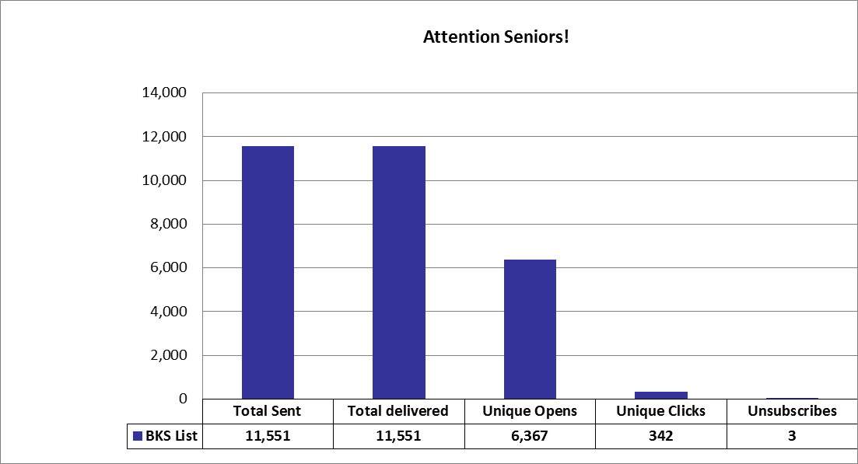
USCAUXILIARYSERVICESIT
Email Campaign Reports
April 2016

Slide 24
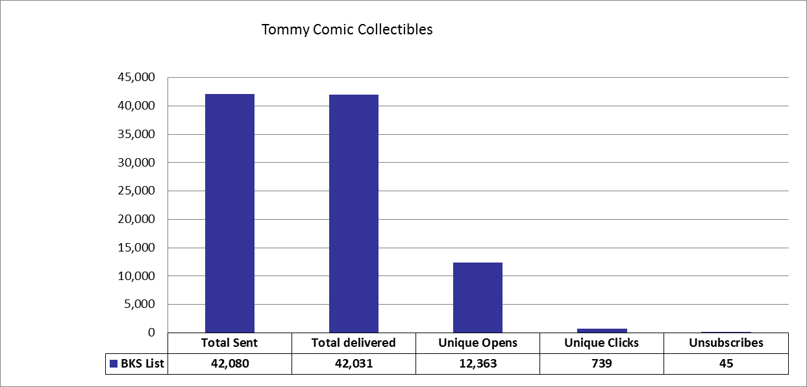
USCAUXILIARYSERVICESIT
Email Campaign Reports
April 2016

Slide 25
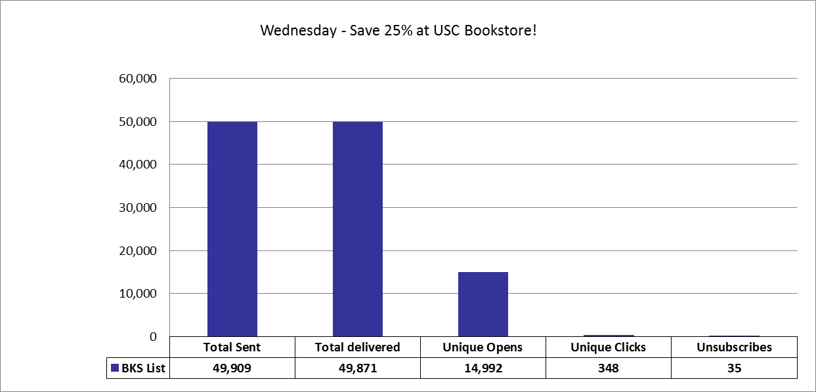
USCAUXILIARYSERVICESIT
Email Campaign Reports
April 2016

Slide 26
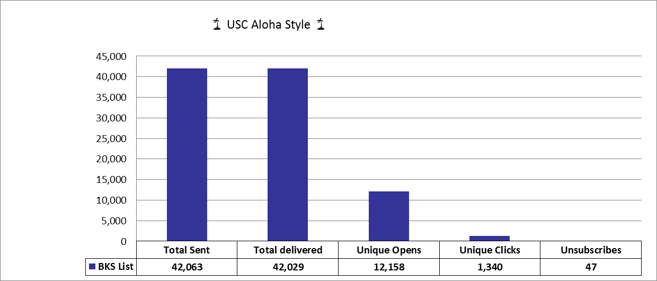
USCAUXILIARYSERVICESIT
Email Campaign Reports
April 2016

Slide 27
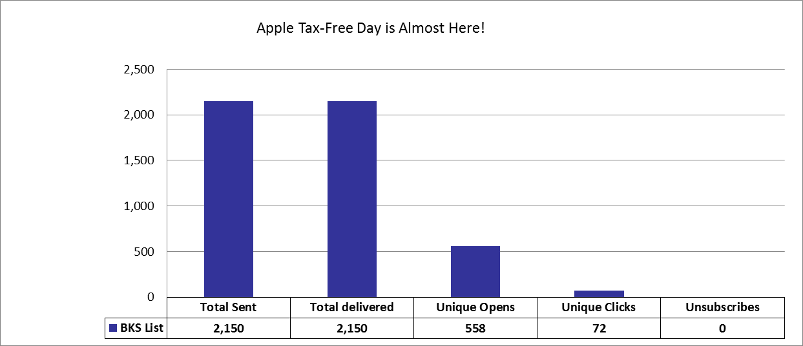
USCAUXILIARYSERVICESIT
Email Campaign Reports
April 2016

Slide 28
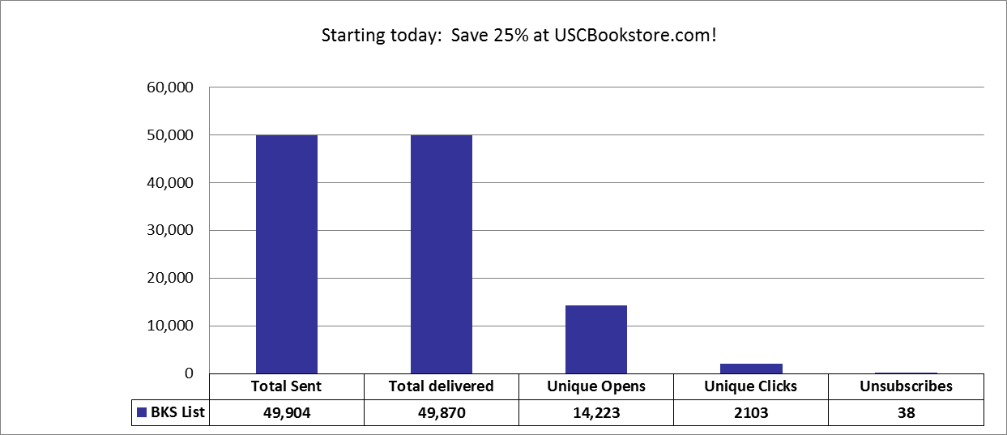
USCAUXILIARYSERVICESIT
Email Campaign Reports
April 2016

Slide 29
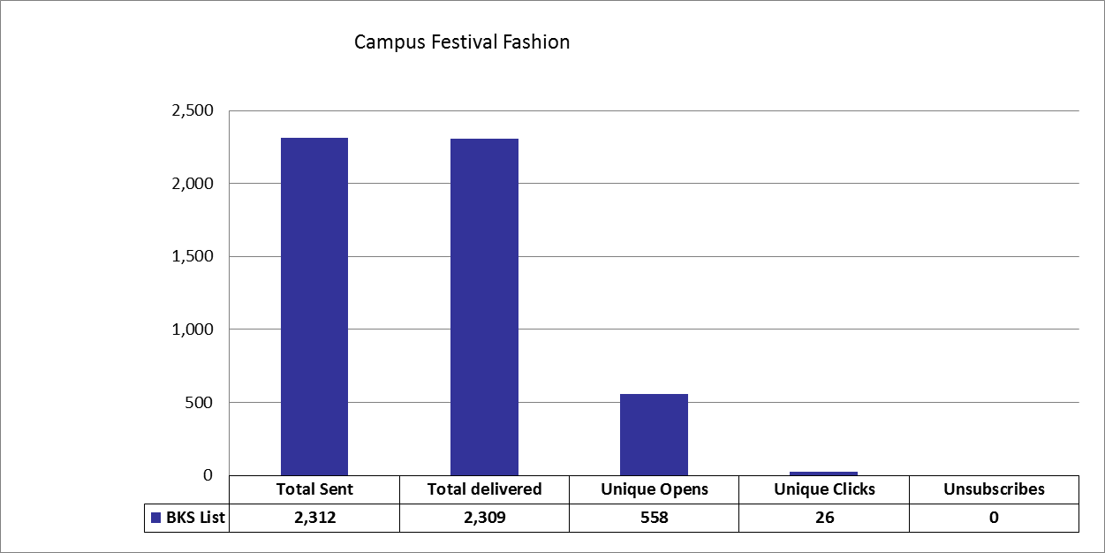
USCAUXILIARYSERVICESIT
Email Campaign Reports
April 2016

Slide 30
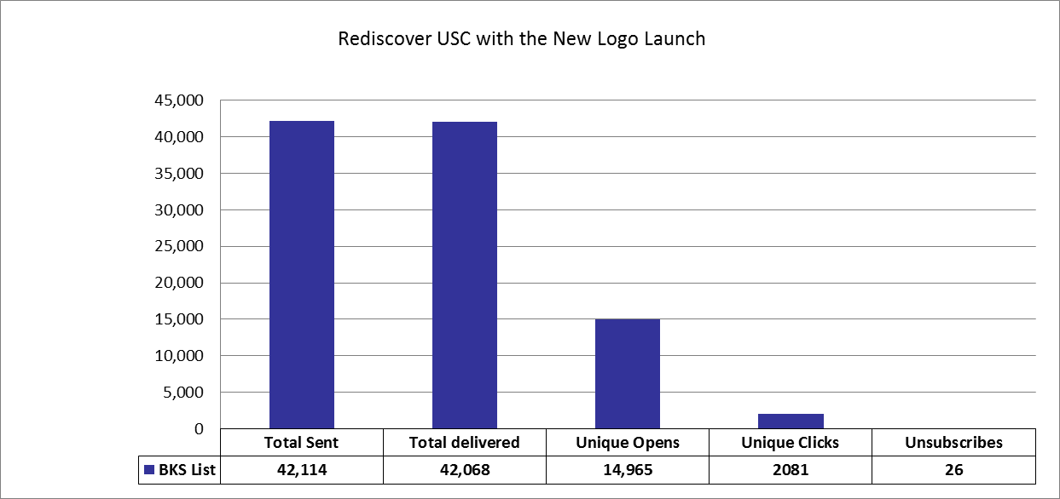
USCAUXILIARYSERVICESIT
Email Campaign Reports
April 2016

Slide 31
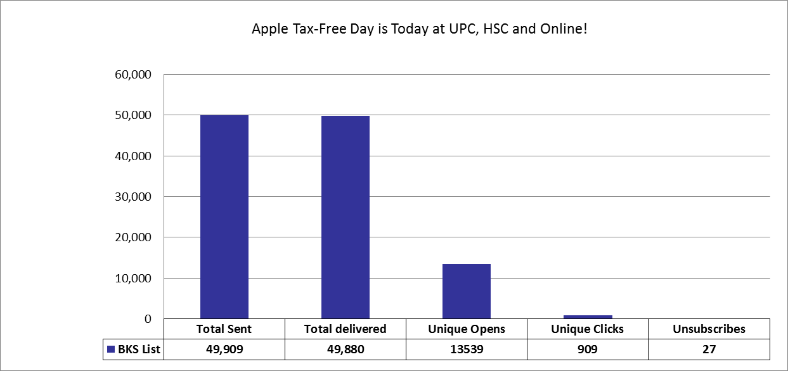
USCAUXILIARYSERVICESIT
Email Campaign Reports
April 2016

Slide 32
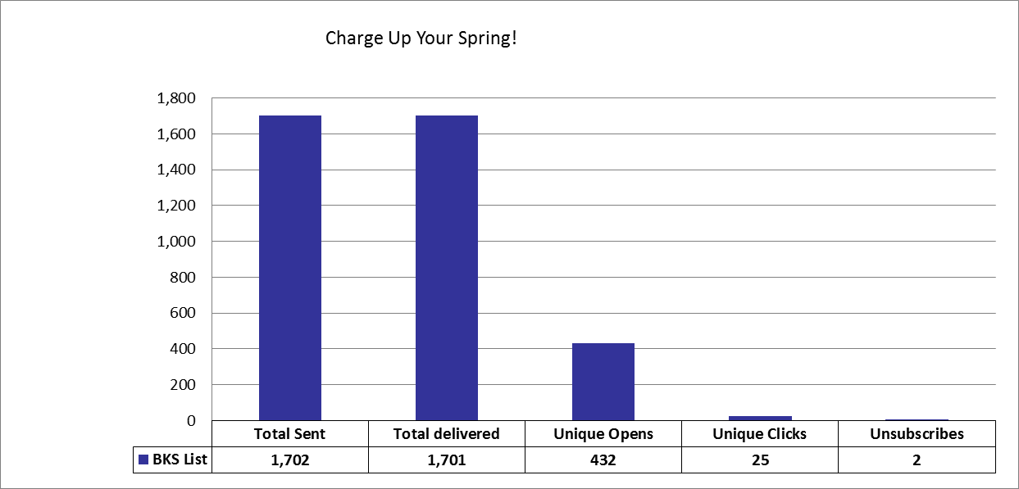
USCAUXILIARYSERVICESIT
Email Campaign Reports
April 2016

Slide 33
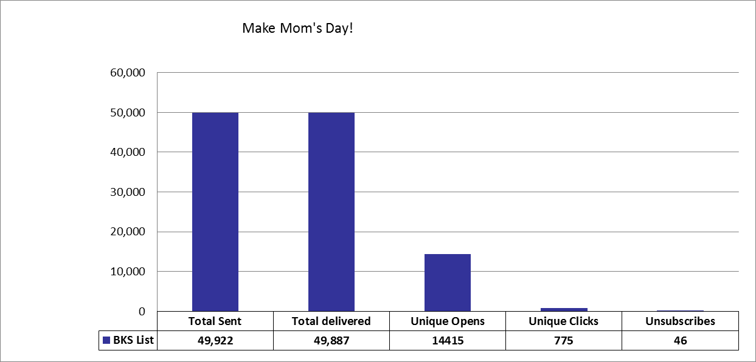
USCAUXILIARYSERVICESIT
Email Campaign Reports
April 2016

Slide 34
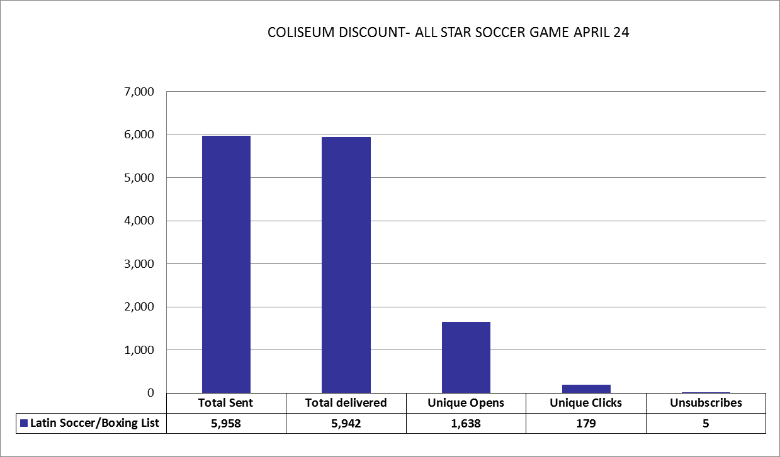
USCAUXILIARYSERVICESIT
Email Campaign Reports
April 2016

Slide 35
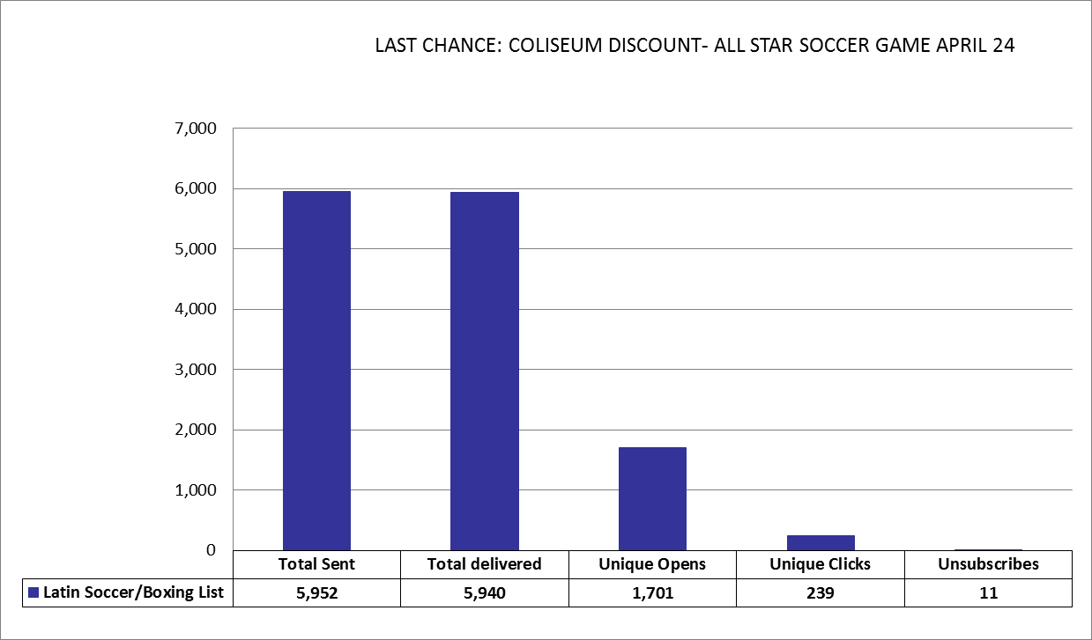
USCAUXILIARYSERVICESIT
Email Campaign Reports
April 2016

Slide 36
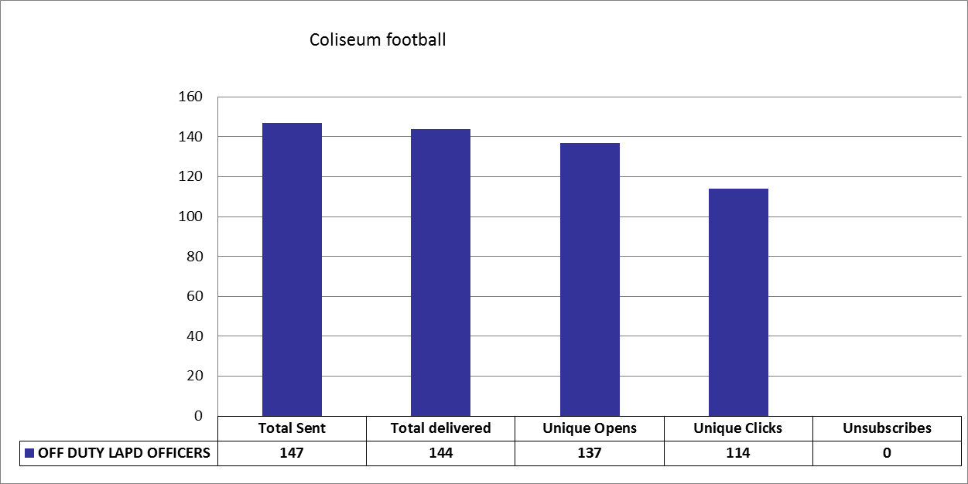
USCAUXILIARYSERVICESIT
Email Campaign Reports
April 2016

Slide 37
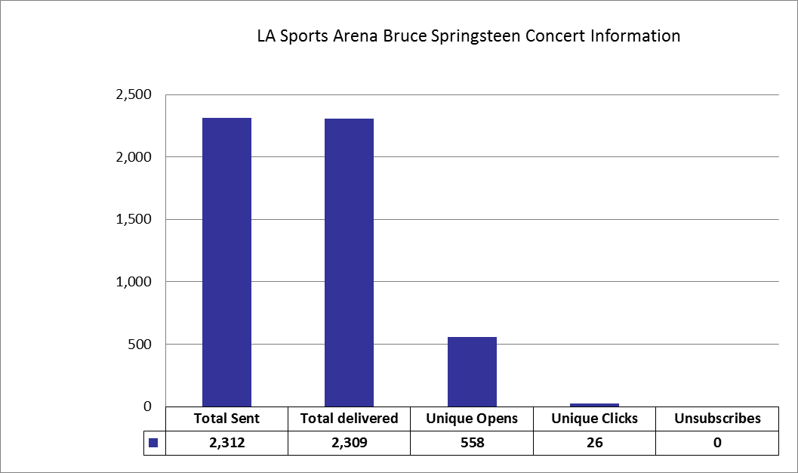
USCAUXILIARYSERVICESIT
Email Campaign Reports
April 2016

Slide 38
USCAUXILIARYSERVICESIT
Customer Satisfaction Report
April 2016

Slide 39
Thank You !!

