Slide 1
AUXILIARYSERVICES
I T
AS IT MONTHLY REPORTS
For February 2016
Notes:
1
Boo
May 4, 2008
USC Auxiliary Services Central IT - Individual Accomplishments

Slide 2
USCAUXILIARY SERVICESIT
AGENDA
Service Desk Reports
Aging Report
Website Reports
Email Campaign Reports
Customer Satisfaction Report

Slide 3
USCAUXILIARYSERVICESIT
Service Desk Reports
February 2016

Slide 4
USCAUXILIARYSERVICESIT
Service Desk Reports
February 2016

Slide 5
USCAUXILIARYSERVICESIT
Service Desk Reports
February 2016

Slide 6
USCAUXILIARYSERVICESIT
Service Desk Reports
February 2016

Slide 7
USCAUXILIARYSERVICESIT
Service Desk Reports
February 2016

Slide 8
USCAUXILIARYSERVICESIT
Service Desk Reports
February 2016

Slide 9
USCAUXILIARYSERVICESIT
Service Desk Reports
February 2016

Slide 10
USCAUXILIARYSERVICESIT
Website Reports
February 2016

Slide 11
USCAUXILIARYSERVICESIT
Website Reports
February 2016

Slide 12
USCAUXILIARYSERVICESIT
Website Reports
February 2016
Notes:
USC Auxiliary Services Central IT - Individual Accomplishments
May 4, 2008
12

Slide 13
USCAUXILIARYSERVICESIT
Website Reports
February 2016

Slide 14
USCAUXILIARYSERVICESIT
Website Reports
February 2016

Slide 15
USCAUXILIARYSERVICESIT
Website Reports
February 2016

Slide 16
USCAUXILIARYSERVICESIT
Website Reports
February 2016

Slide 17
USC AUXILIARY SERVICES IT
Website Reports
February 2016

Slide 18
USC AUXILIARY SERVICES IT
Website Reports
February 2016

Slide 19
USCAUXILIARYSERVICESIT
Website Reports
February 2016

Slide 20
USCAUXILIARYSERVICESIT
Website Reports
February 2016

Slide 21
USCAUXILIARYSERVICESIT
Website Reports
February 2016

Slide 22
USCAUXILIARYSERVICESIT
Website Reports
February 2016

Slide 23
USCAUXILIARYSERVICESIT
Email Campaign Reports
February 2016

Slide 24
USCAUXILIARYSERVICESIT
Email Campaign Reports
February 2016

Slide 25
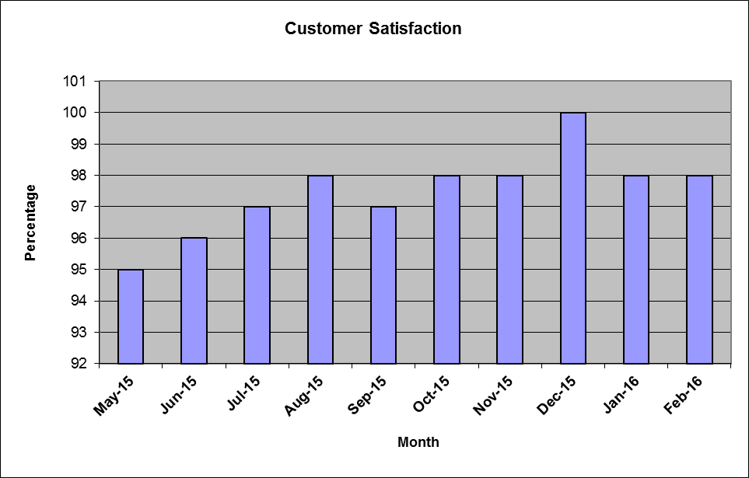
USCAUXILIARYSERVICESIT
Customer Satisfaction Report
February 2016

Slide 26
Thank You !!

