Slide 1
AUXILIARYSERVICES
I T
AS IT MONTHLY REPORTS
For November 2015
Notes:
1
Boo
May 4, 2008
USC Auxiliary Services Central IT - Individual Accomplishments

Slide 2
USCAUXILIARY SERVICESIT
AGENDA
Service Desk Reports
Aging Report
Website Reports
Email Campaign Reports
Customer Satisfaction Report

Slide 3
USCAUXILIARYSERVICESIT
Service Desk Reports
November 2015

Slide 4
USCAUXILIARYSERVICESIT
Service Desk Reports
November 2015

Slide 5
USCAUXILIARYSERVICESIT
Service Desk Reports
November 2015

Slide 6
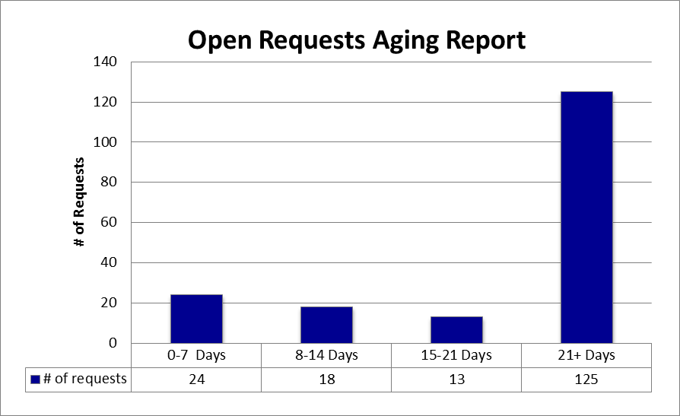
USCAUXILIARYSERVICESIT
Service Desk Reports
November 2015

Slide 7
USCAUXILIARYSERVICESIT
Service Desk Reports
November 2015

Slide 8
USCAUXILIARYSERVICESIT
Service Desk Reports
November 2015

Slide 9
USCAUXILIARYSERVICESIT
Service Desk Reports
November 2015

Slide 10
USCAUXILIARYSERVICESIT
Website Reports
November 2015

Slide 11
USCAUXILIARYSERVICESIT
Website Reports
November 2015

Slide 12
USCAUXILIARYSERVICESIT
Website Reports
November 2015
Notes:
USC Auxiliary Services Central IT - Individual Accomplishments
May 4, 2008
12

Slide 13
USCAUXILIARYSERVICESIT
Website Reports
November 2015

Slide 14
USCAUXILIARYSERVICESIT
Website Reports
November 2015

Slide 15
USCAUXILIARYSERVICESIT
Website Reports
November 2015

Slide 16
USCAUXILIARYSERVICESIT
Website Reports
November 2015

Slide 17
USCAUXILIARYSERVICESIT
Website Reports
November 2015

Slide 18
USCAUXILIARYSERVICESIT
Website Reports
November 2015

Slide 19
USCAUXILIARYSERVICESIT
Website Reports
November 2015

Slide 20
USCAUXILIARYSERVICESIT
Website Reports
November 2015

Slide 21
USCAUXILIARYSERVICESIT
Website Reports
November 2015

Slide 22
USCAUXILIARYSERVICESIT
Website Reports
November 2015

Slide 23
USCAUXILIARYSERVICESIT
Email Campaign Reports
November 2015

Slide 24
USCAUXILIARYSERVICESIT
Customer Satisfaction Report
November 2015

Slide 25
Thank You !!

