Slide 1
AUXILIARYSERVICES
I T
AS IT MONTHLY REPORTS
For September 2015
Notes:
1
Boo
May 4, 2008
USC Auxiliary Services Central IT - Individual Accomplishments

Slide 2
USCAUXILIARY SERVICESIT
AGENDA
Service Desk Reports
Aging Report
Website Reports
Email Campaign Reports
Customer Satisfaction Report

Slide 3
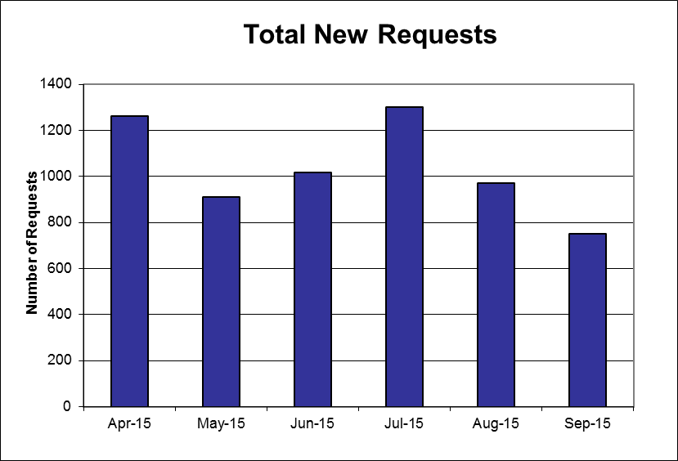
USCAUXILIARYSERVICESIT
Service Desk Reports
September 2015

Slide 4
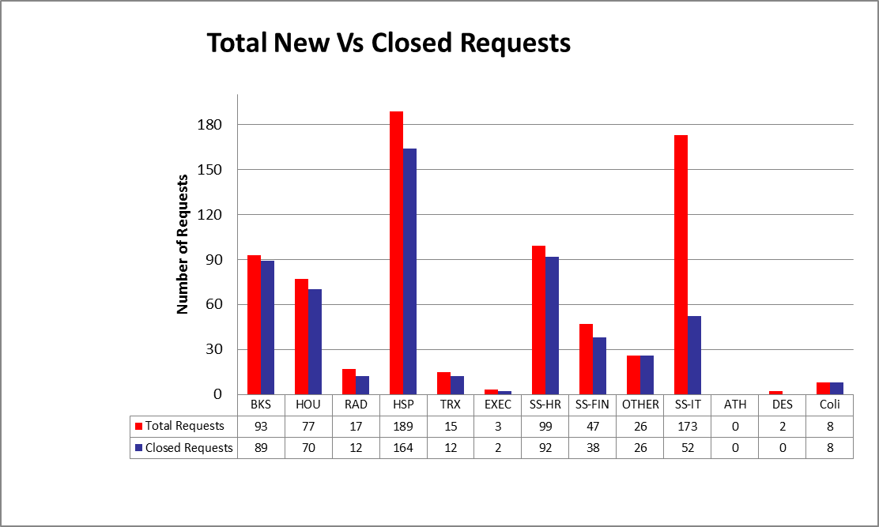
USCAUXILIARYSERVICESIT
Service Desk Reports
September 2015

Slide 5
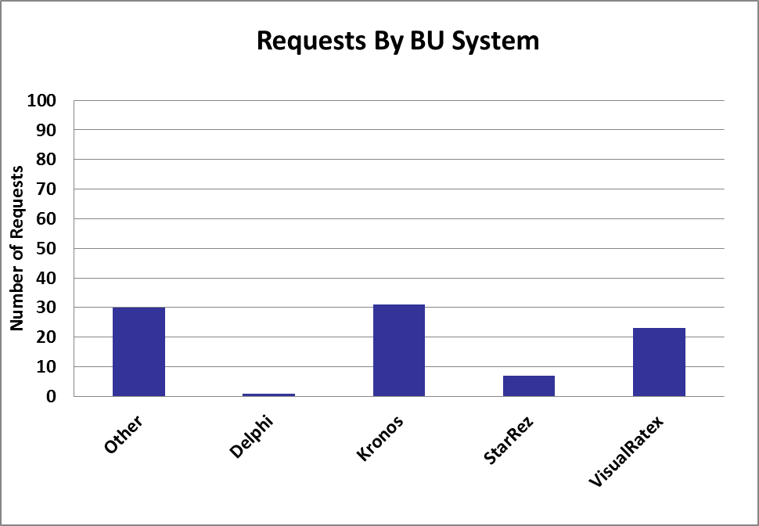
USCAUXILIARYSERVICESIT
Service Desk Reports
September 2015

Slide 6
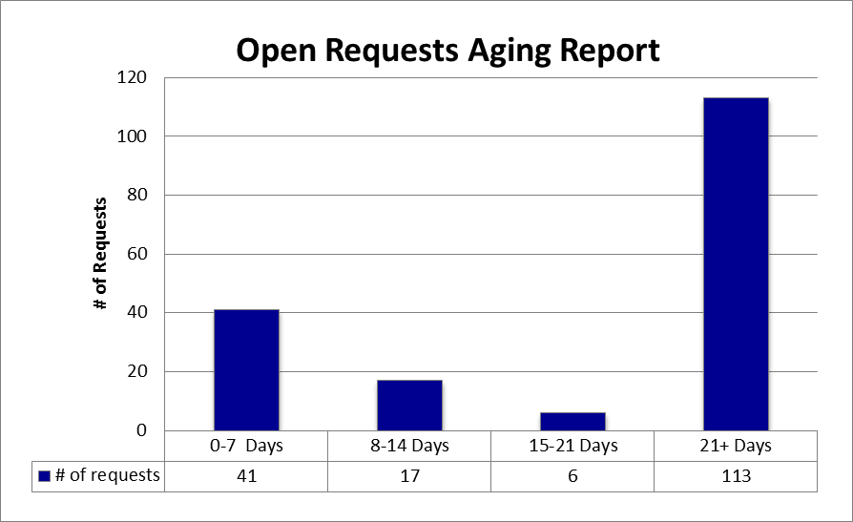
USCAUXILIARYSERVICESIT
Service Desk Reports
September 2015

Slide 7
USCAUXILIARYSERVICESIT
Service Desk Reports
September 2015

Slide 8
USCAUXILIARYSERVICESIT
Service Desk Reports
September 2015

Slide 9
USCAUXILIARYSERVICESIT
Service Desk Reports
September 2015

Slide 10
USCAUXILIARYSERVICESIT
Website Reports
September 2015

Slide 11
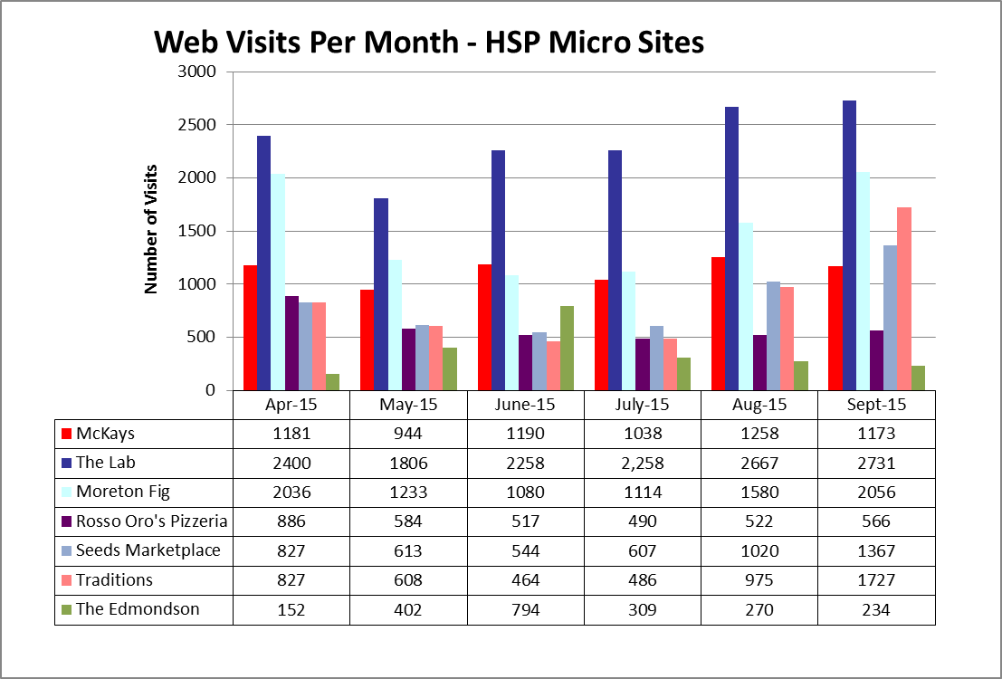
USCAUXILIARYSERVICESIT
Website Reports
September 2015

Slide 12
USCAUXILIARYSERVICESIT
Website Reports
September 2015
Notes:
USC Auxiliary Services Central IT - Individual Accomplishments
May 4, 2008
12

Slide 13
USCAUXILIARYSERVICESIT
Website Reports
September 2015

Slide 14
USCAUXILIARYSERVICESIT
Website Reports
September 2015

Slide 15
USCAUXILIARYSERVICESIT
Website Reports
September 2015

Slide 16
USCAUXILIARYSERVICESIT
Website Reports
September 2015

Slide 17
USCAUXILIARYSERVICESIT
Website Reports
September 2015

Slide 18
USCAUXILIARYSERVICESIT
Website Reports
September 2015

Slide 19
USCAUXILIARYSERVICESIT
Website Reports
September 2015

Slide 20
USCAUXILIARYSERVICESIT
Website Reports
September 2015

Slide 21
USCAUXILIARYSERVICESIT
Website Reports
September 2015

Slide 22
USCAUXILIARYSERVICESIT
Website Reports
May 2015

Slide 23
USCAUXILIARYSERVICESIT
Email Campaign Reports
September 2015

Slide 24
USCAUXILIARYSERVICESIT
Email Campaign Reports
September 2015

Slide 25
USCAUXILIARYSERVICESIT
Email Campaign Reports
September 2015

Slide 26
USCAUXILIARYSERVICESIT
Email Campaign Reports
September 2015

Slide 27
USCAUXILIARYSERVICESIT
Email Campaign Reports
September 2015

Slide 28
USCAUXILIARYSERVICESIT
Email Campaign Reports
September 2015

Slide 29
USCAUXILIARYSERVICESIT
Email Campaign Reports
September 2015

Slide 30
USCAUXILIARYSERVICESIT
Customer Satisfaction Report
September 2015

Slide 31
Thank You !!

