Slide 1
AUXILIARYSERVICES
I T
AS IT MONTHLY REPORTS
For April 2017
Notes:
1
Boo
May 4, 2008
USC Auxiliary Services Central IT - Individual Accomplishments

Slide 2
USCAUXILIARY SERVICESIT
AGENDA
Service Desk Reports
Aging Report
Website Reports
Email Campaign Reports
Customer Satisfaction Report

Slide 3
USCAUXILIARYSERVICESIT
Service Desk Reports
April 2017

Slide 4
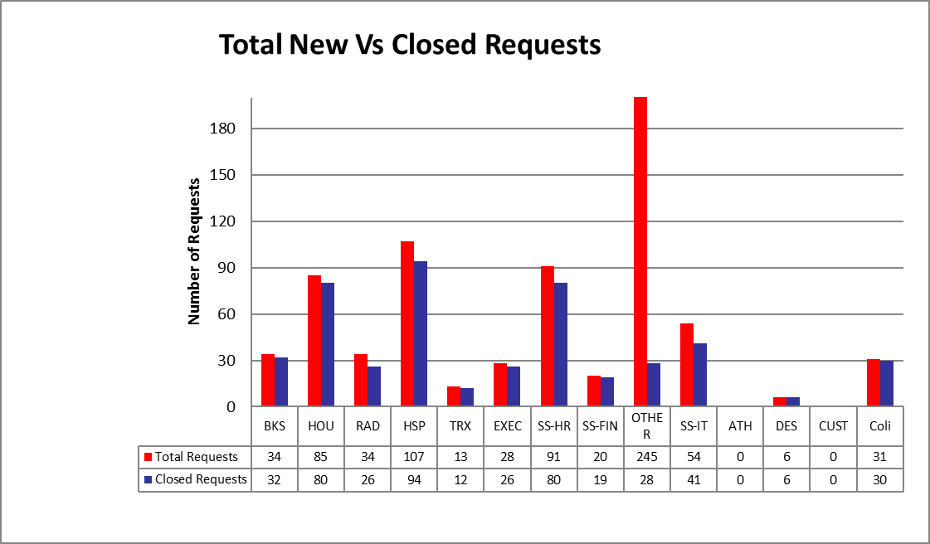
USCAUXILIARYSERVICESIT
Service Desk Reports
April 2017

Slide 5
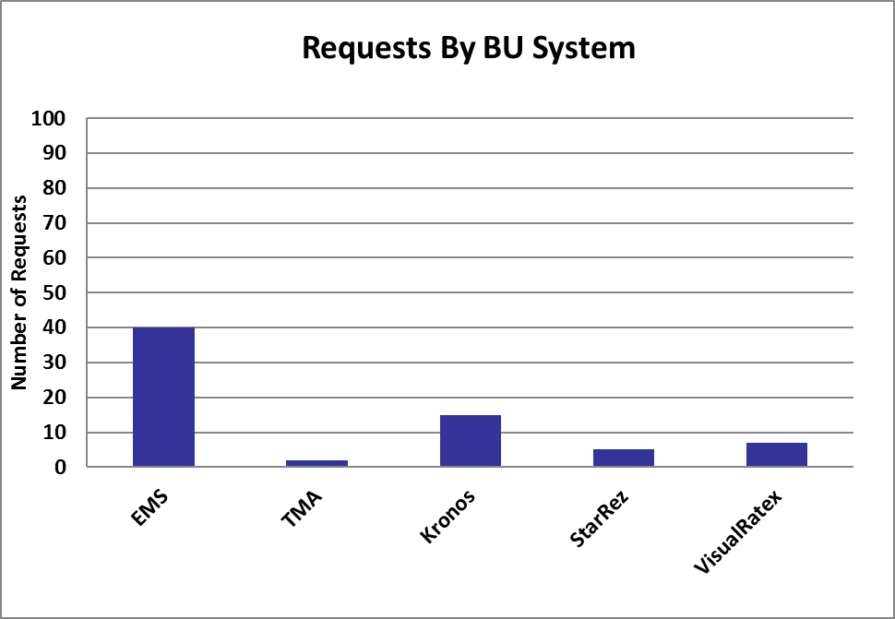
USCAUXILIARYSERVICESIT
Service Desk Reports
April 2017

Slide 6
USCAUXILIARYSERVICESIT
Service Desk Reports
April 2017

Slide 7
USCAUXILIARYSERVICESIT
Service Desk Reports
April 2017

Slide 8
USCAUXILIARYSERVICESIT
Service Desk Reports
April 2017

Slide 9
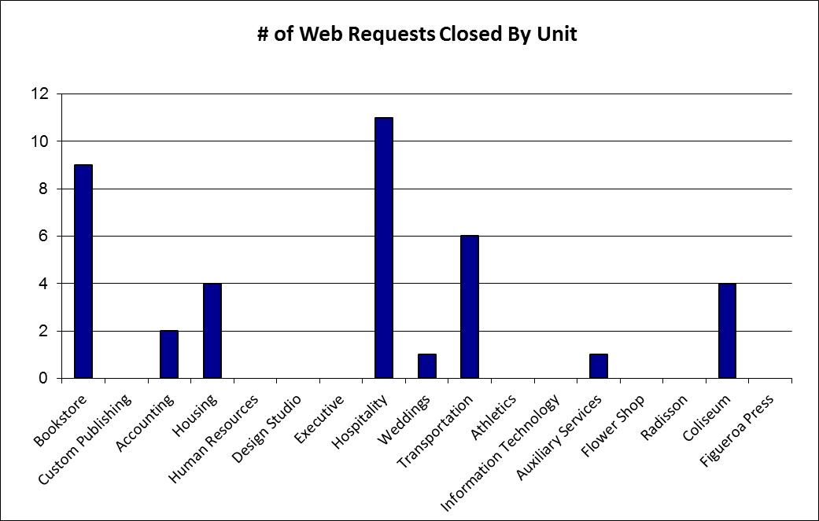
USCAUXILIARYSERVICESIT
Service Desk Reports
April 2017

Slide 10
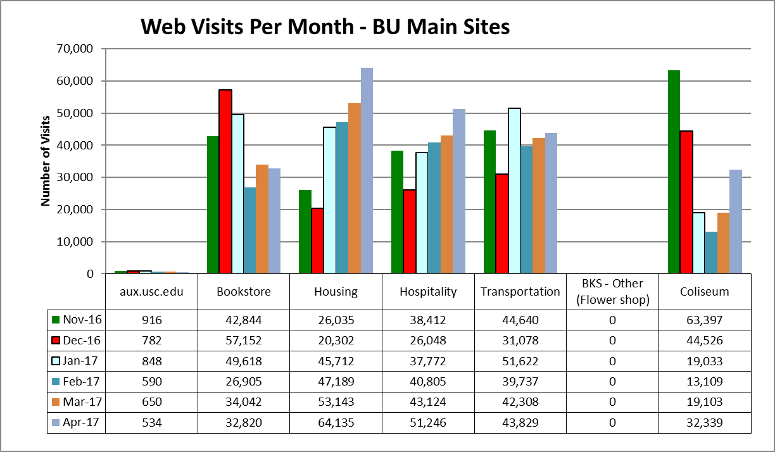
USCAUXILIARYSERVICESIT
Website Reports
April 2017

Slide 11
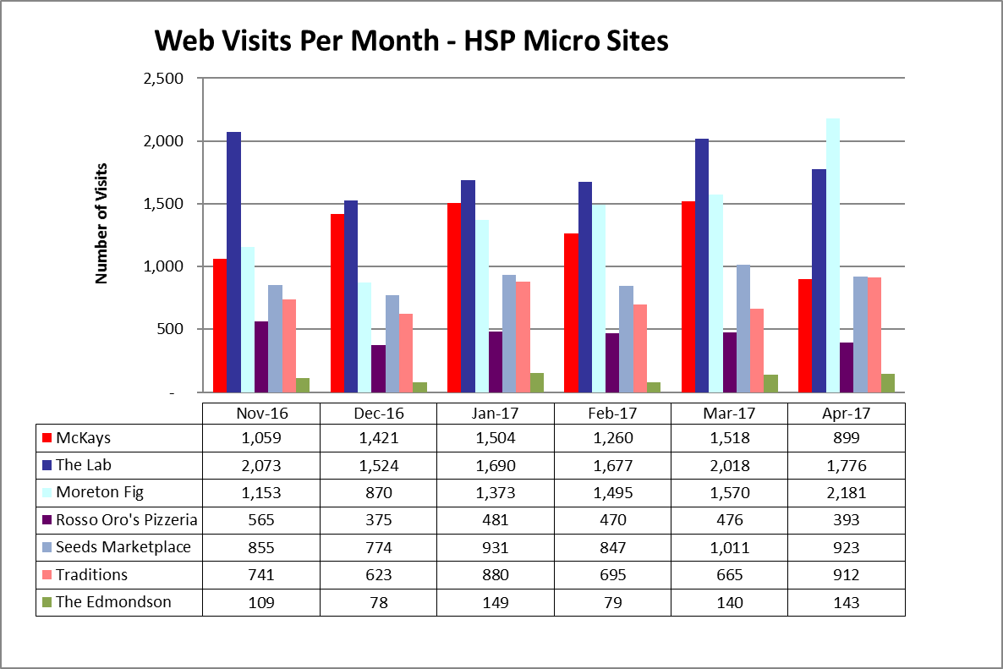
USCAUXILIARYSERVICESIT
Website Reports
April 2017

Slide 12
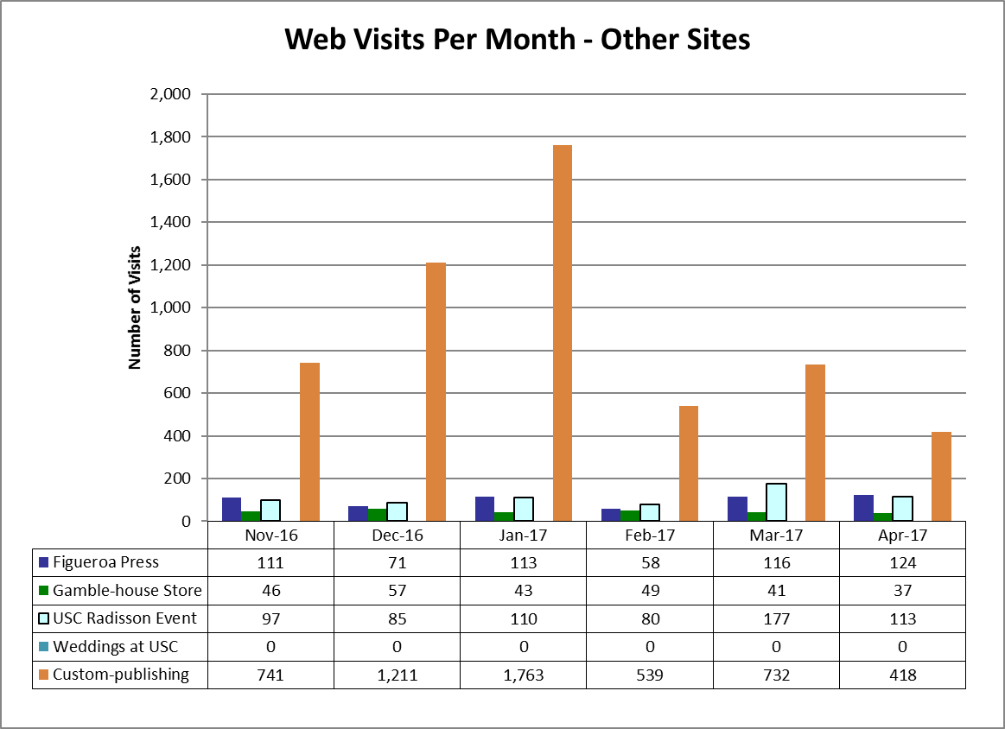
USCAUXILIARYSERVICESIT
Website Reports
April 2017
Notes:
USC Auxiliary Services Central IT - Individual Accomplishments
May 4, 2008
12

Slide 13
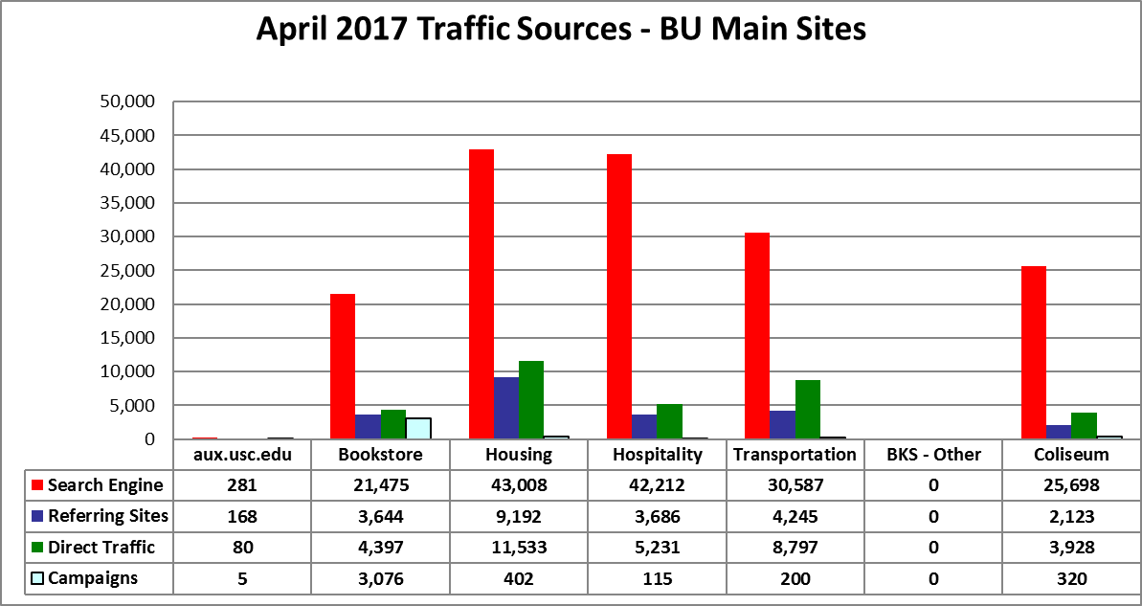
USCAUXILIARYSERVICESIT
Website Reports
April 2017

Slide 14
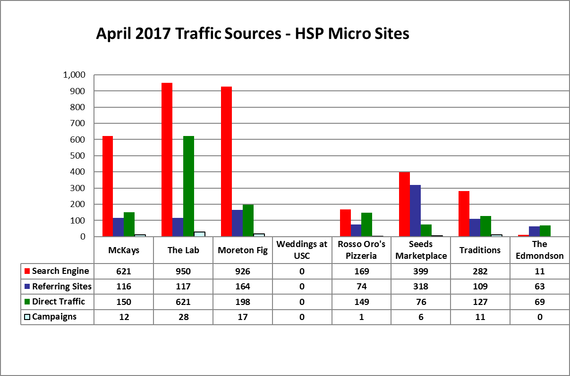
USCAUXILIARYSERVICESIT
Website Reports
April 2017

Slide 15
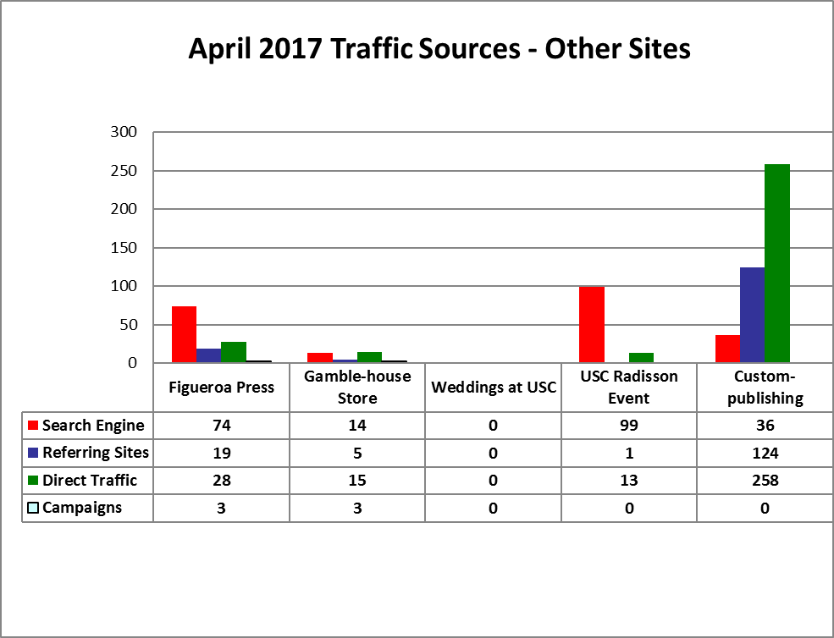
USCAUXILIARYSERVICESIT
Website Reports
April 2017

Slide 16
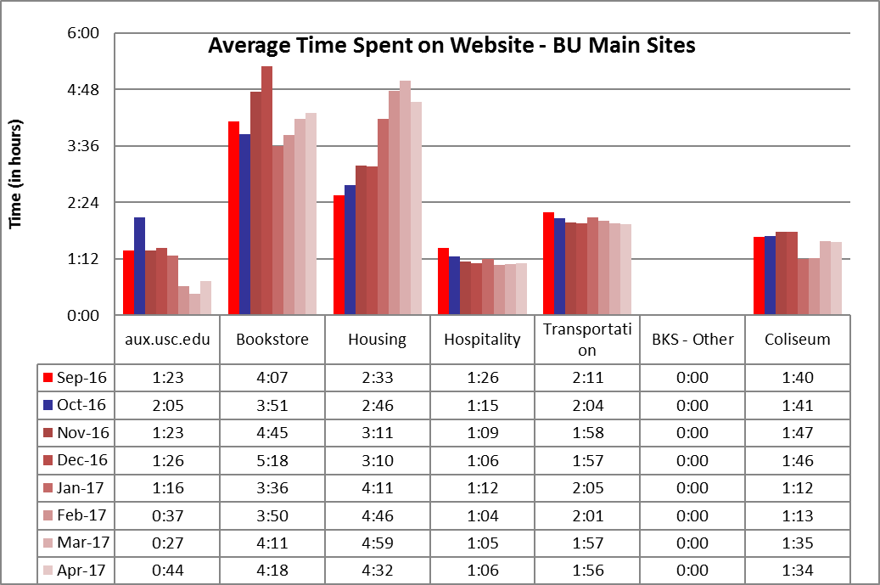
USCAUXILIARYSERVICESIT
Website Reports
April 2017

Slide 17
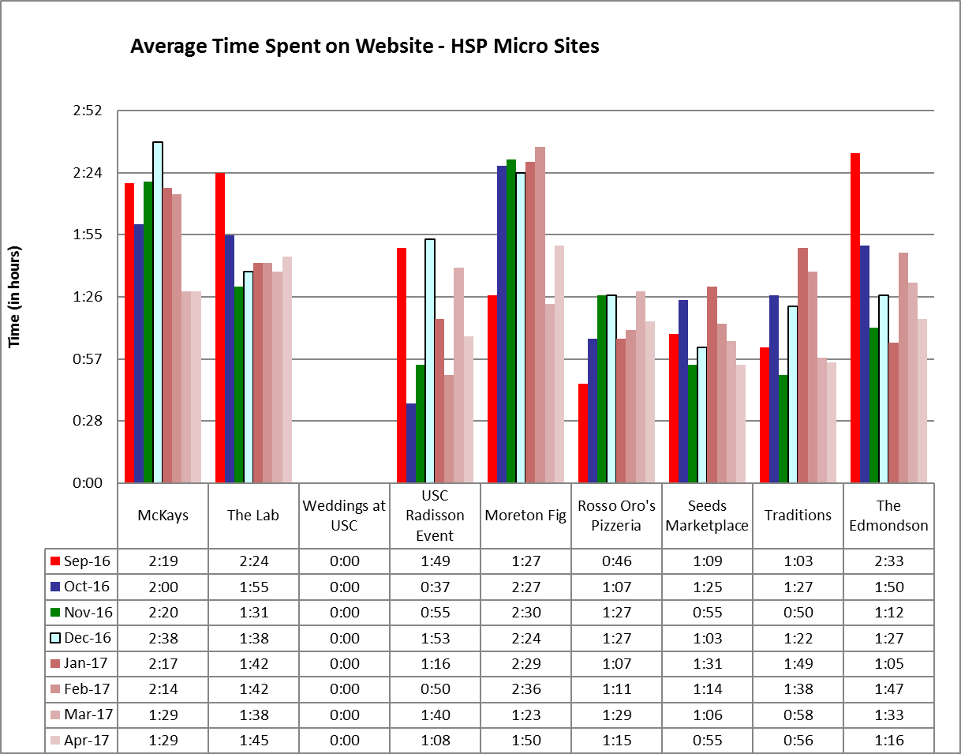
USCAUXILIARYSERVICESIT
Website Reports
April 2017

Slide 18
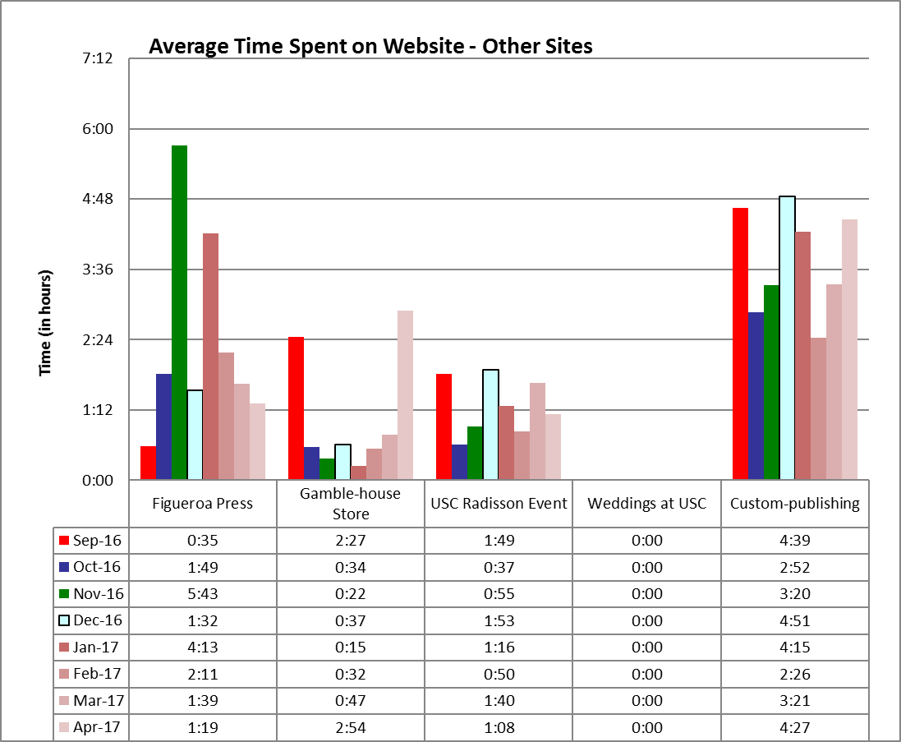
USCAUXILIARYSERVICESIT
Website Reports
April 2017

Slide 19
USCAUXILIARYSERVICESIT
Website Reports
April 2017

Slide 20
USCAUXILIARYSERVICESIT
Website Reports
April 2017

Slide 21
USCAUXILIARYSERVICESIT
Website Reports
April 2017

Slide 22
USCAUXILIARYSERVICESIT
Website Reports
April 2017

Slide 23
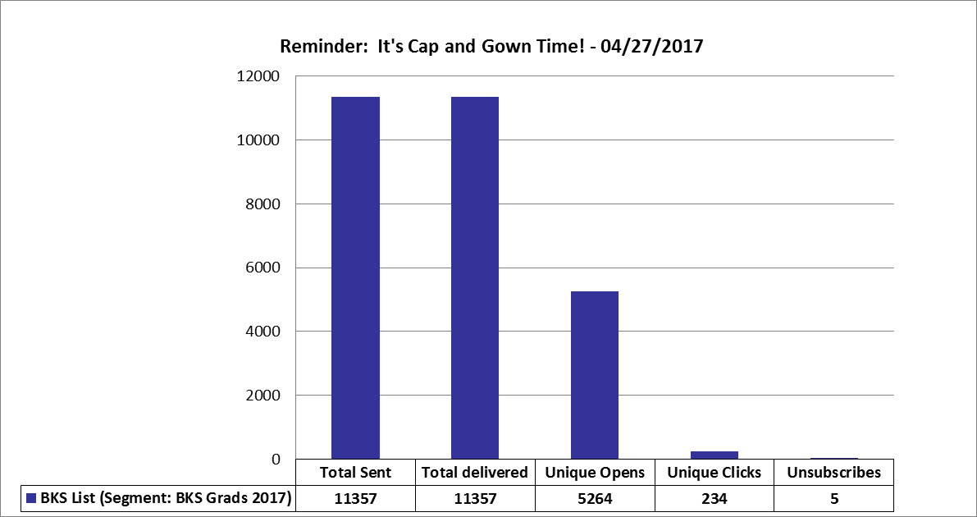
USCAUXILIARYSERVICESIT
Email Campaign Reports
April 2017

Slide 24
USCAUXILIARYSERVICESIT
Email Campaign Reports
April 2017

Slide 25
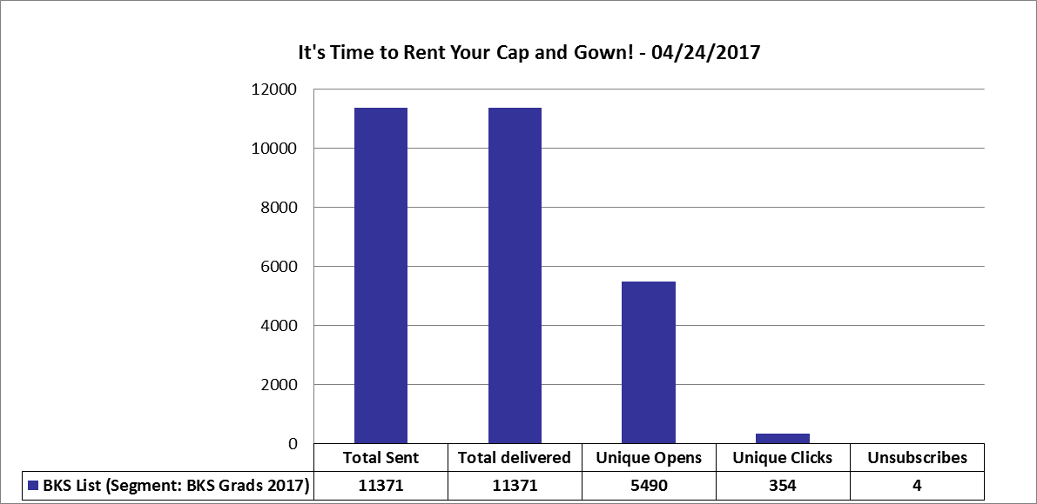
USCAUXILIARYSERVICESIT
Email Campaign Reports
April 2017

Slide 26
USCAUXILIARYSERVICESIT
Email Campaign Reports
April 2017

Slide 27
USCAUXILIARYSERVICESIT
Email Campaign Reports
April 2017

Slide 28
USCAUXILIARYSERVICESIT
Email Campaign Reports
April 2017

Slide 29
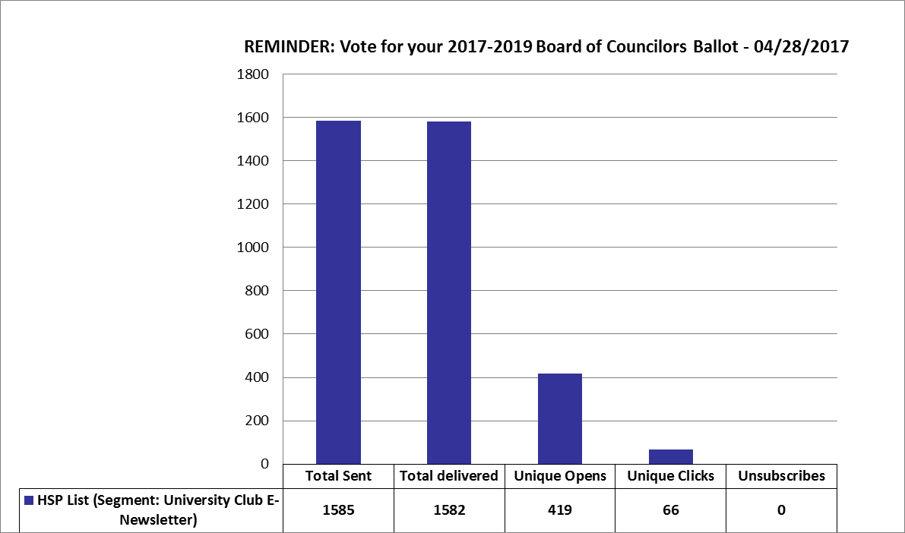
USCAUXILIARYSERVICESIT
Email Campaign Reports
April 2017

Slide 30
USCAUXILIARYSERVICESIT
Email Campaign Reports
April 2017

Slide 31
USCAUXILIARYSERVICESIT
Email Campaign Reports
April 2017

Slide 32
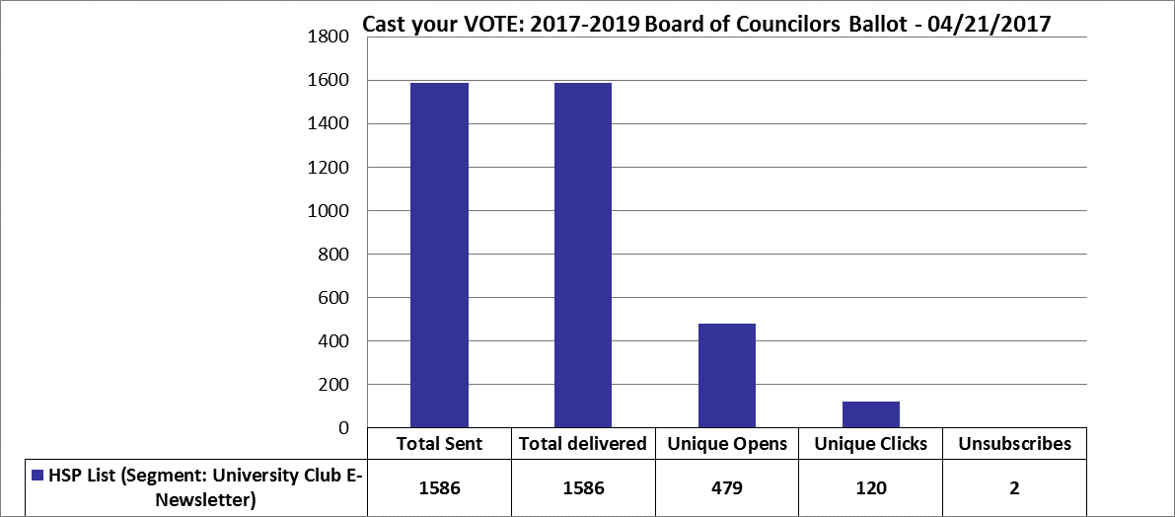
USCAUXILIARYSERVICESIT
Email Campaign Reports
April 2017

Slide 33
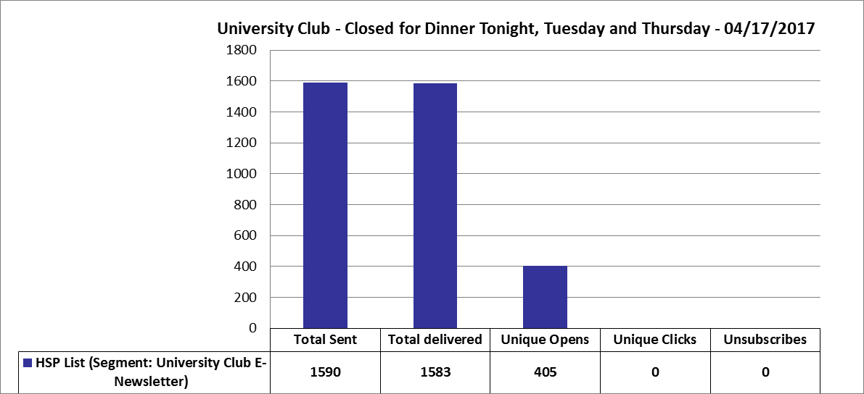
USCAUXILIARYSERVICESIT
Email Campaign Reports
April 2017

Slide 34
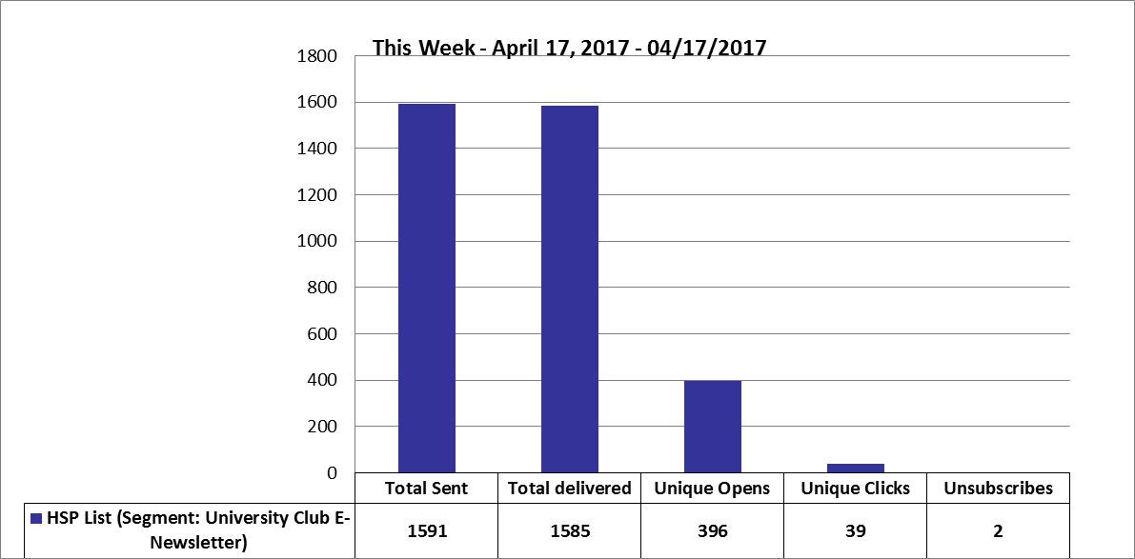
USCAUXILIARYSERVICESIT
Email Campaign Reports
April 2017

Slide 35
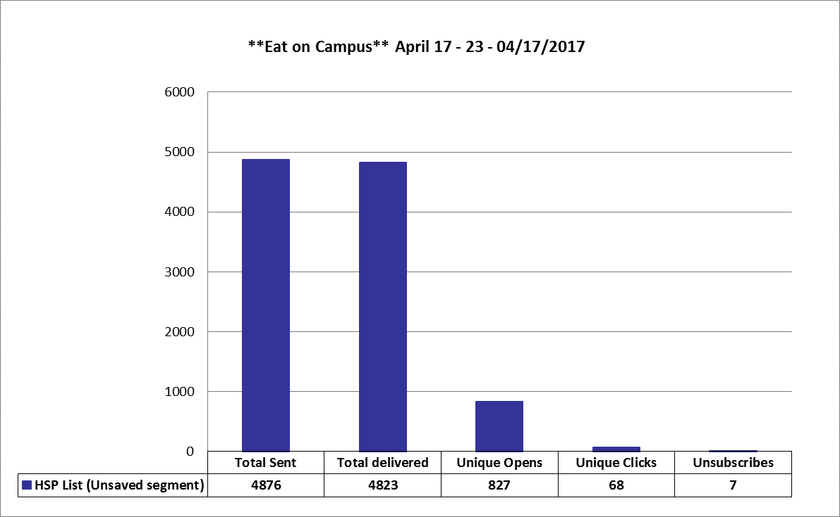
USCAUXILIARYSERVICESIT
Email Campaign Reports
April 2017

Slide 36
USCAUXILIARYSERVICESIT
Email Campaign Reports
April 2017

Slide 37
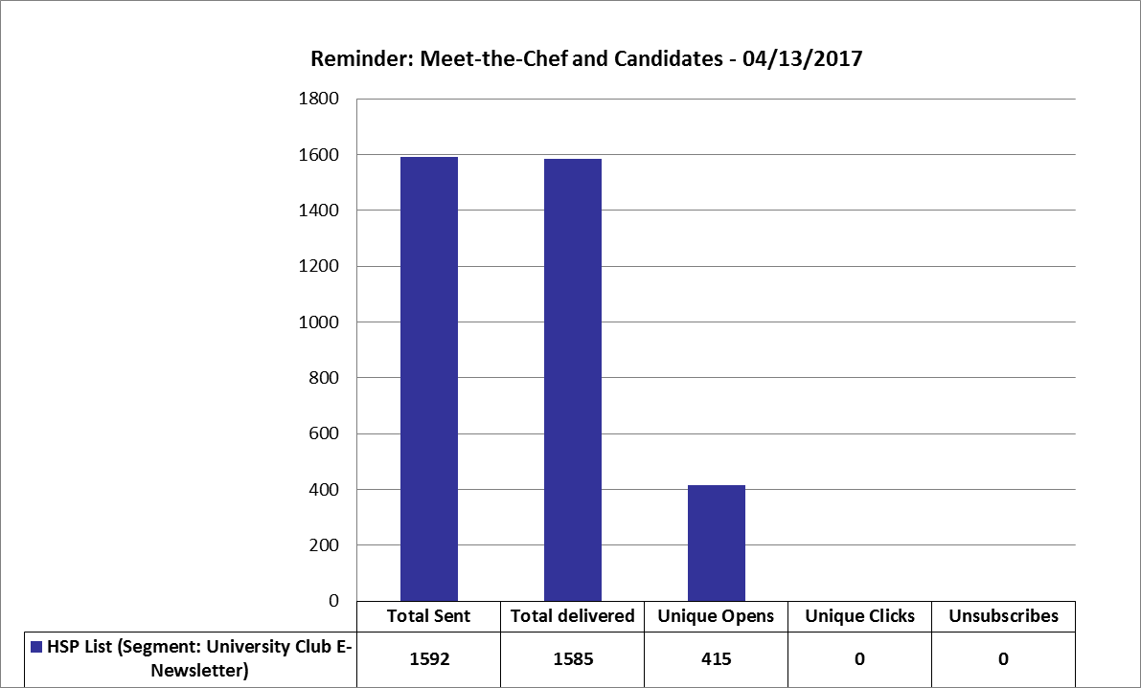
USCAUXILIARYSERVICESIT
Email Campaign Reports
April 2017

Slide 38
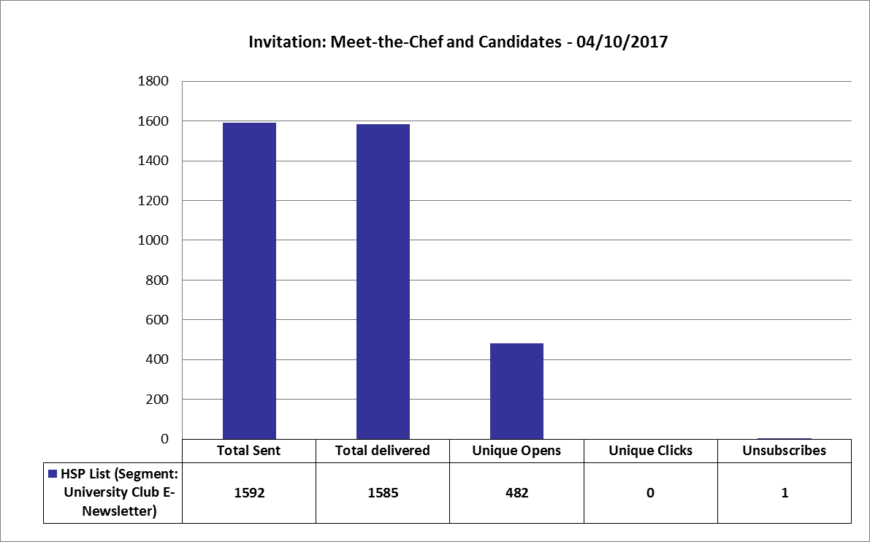
USCAUXILIARYSERVICESIT
Email Campaign Reports
April 2017

Slide 39
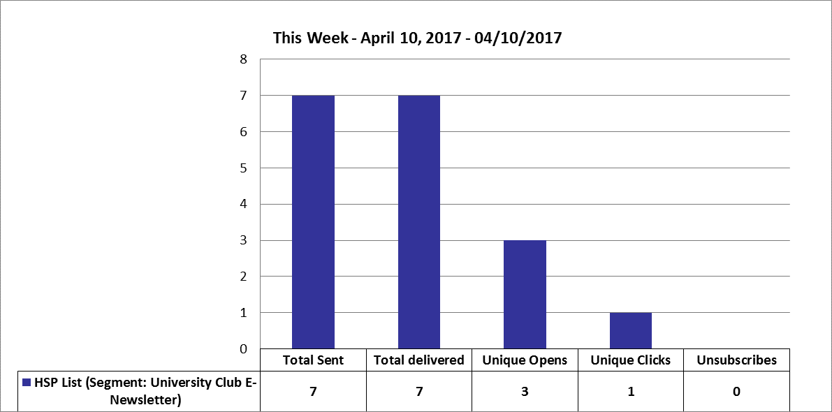
USCAUXILIARYSERVICESIT
Email Campaign Reports
April 2017

Slide 40
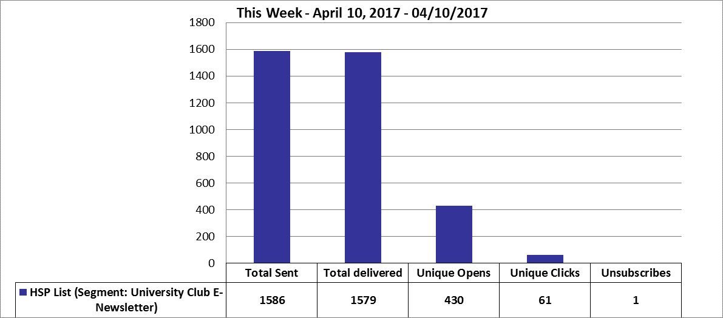
USCAUXILIARYSERVICESIT
Email Campaign Reports
April 2017

Slide 41
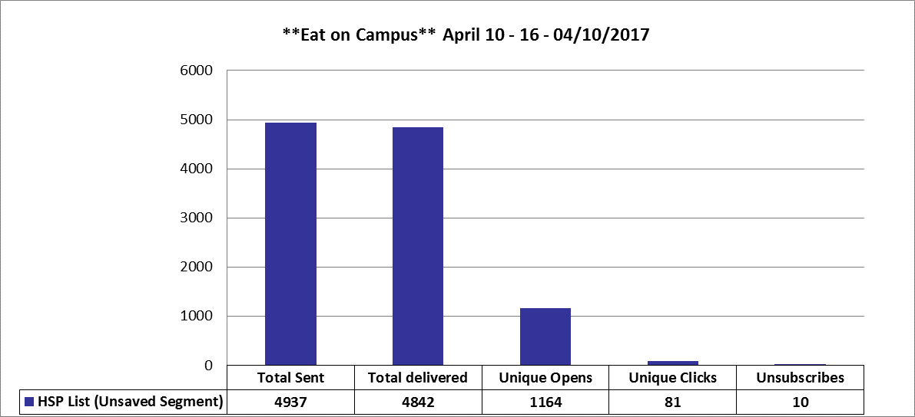
USCAUXILIARYSERVICESIT
Email Campaign Reports
April 2017

Slide 42
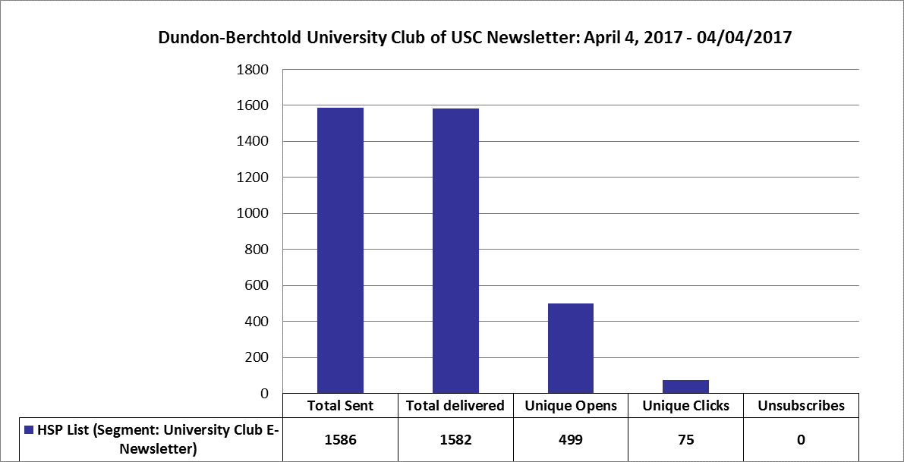
USCAUXILIARYSERVICESIT
Email Campaign Reports
April 2017

Slide 43
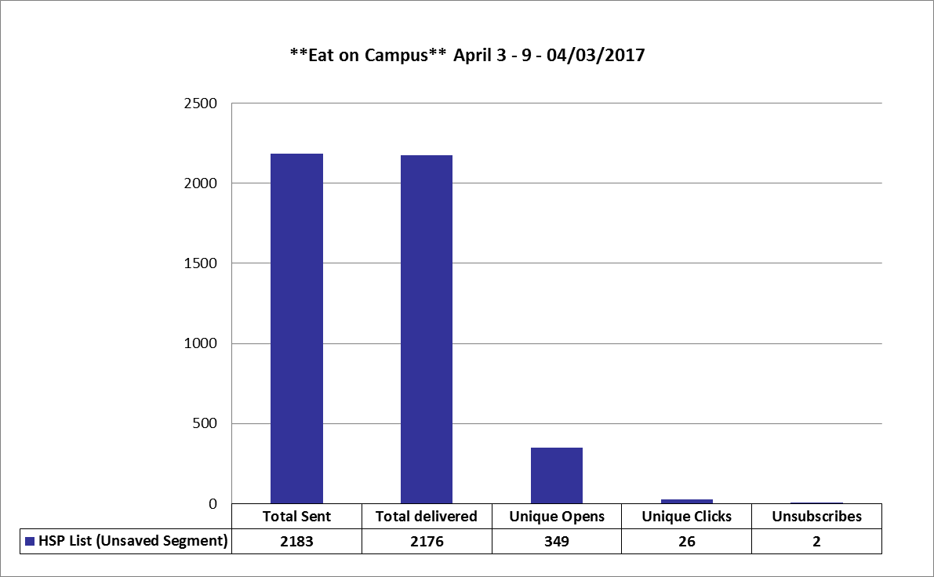
USCAUXILIARYSERVICESIT
Email Campaign Reports
April 2017

Slide 44
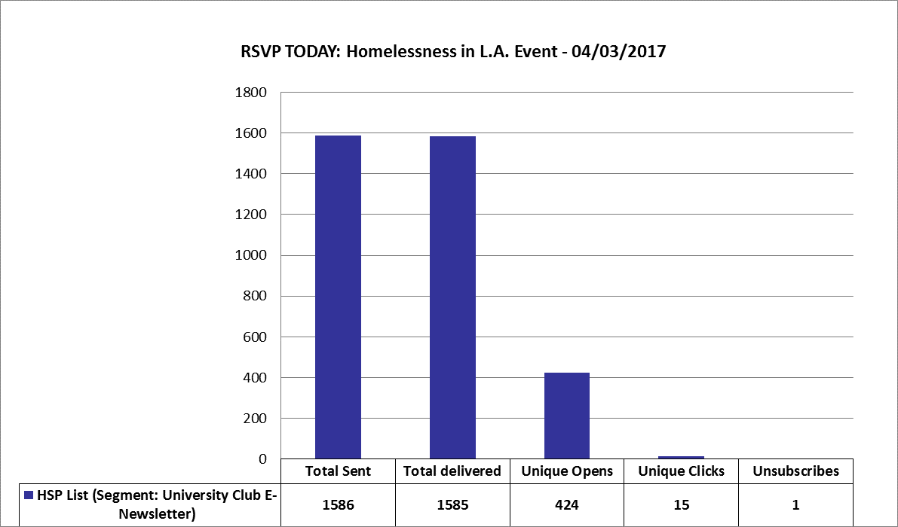
USCAUXILIARYSERVICESIT
Email Campaign Reports
April 2017

Slide 45
USCAUXILIARYSERVICESIT
Customer Satisfaction Report
April 2017

Slide 46
Thank You !!

