Slide 1
AUXILIARYSERVICES
I T
AS IT MONTHLY REPORTS
For June 2017
Notes:
1
Boo
June 4, 2008
USC Auxiliary Services Central IT - Individual Accomplishments

Slide 2
USCAUXILIARY SERVICESIT
AGENDA
Service Desk Reports
Aging Report
Website Reports
Email Campaign Reports
Customer Satisfaction Report

Slide 3
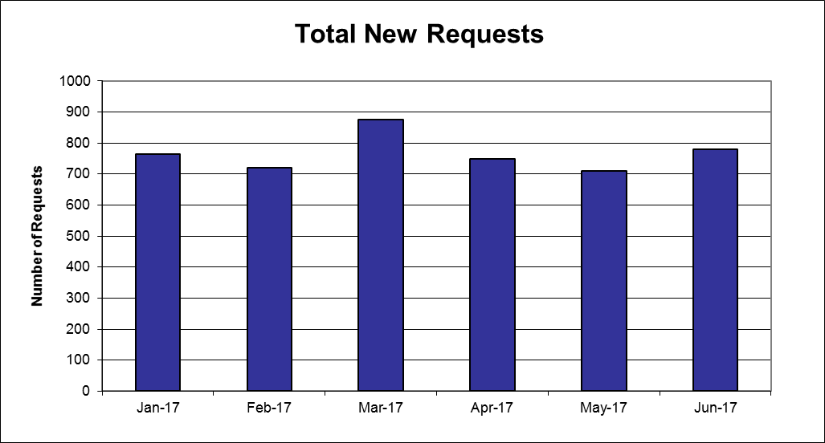
USCAUXILIARYSERVICESIT
Service Desk Reports
June 2017

Slide 4
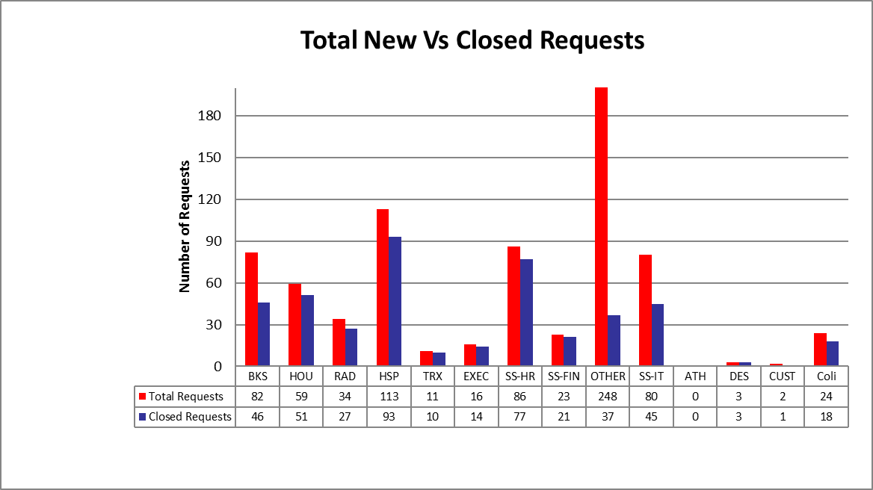
USCAUXILIARYSERVICESIT
Service Desk Reports
June 2017

Slide 5
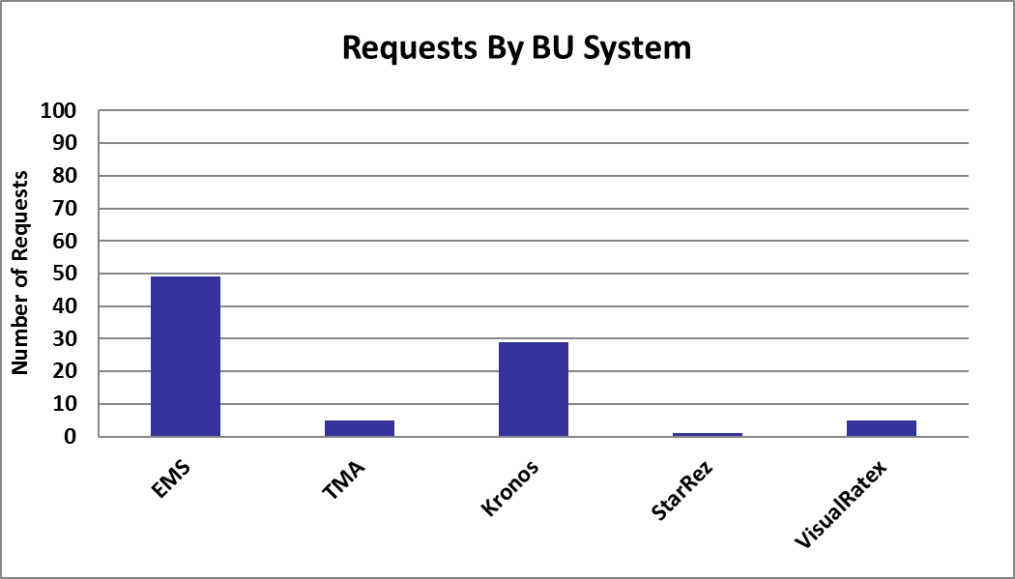
USCAUXILIARYSERVICESIT
Service Desk Reports
June 2017

Slide 6
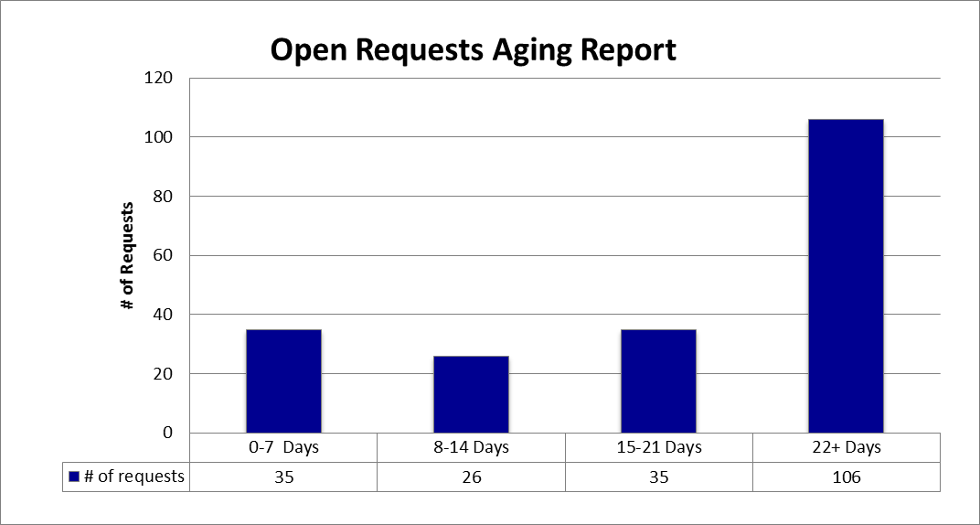
USCAUXILIARYSERVICESIT
Service Desk Reports
June 2017

Slide 7
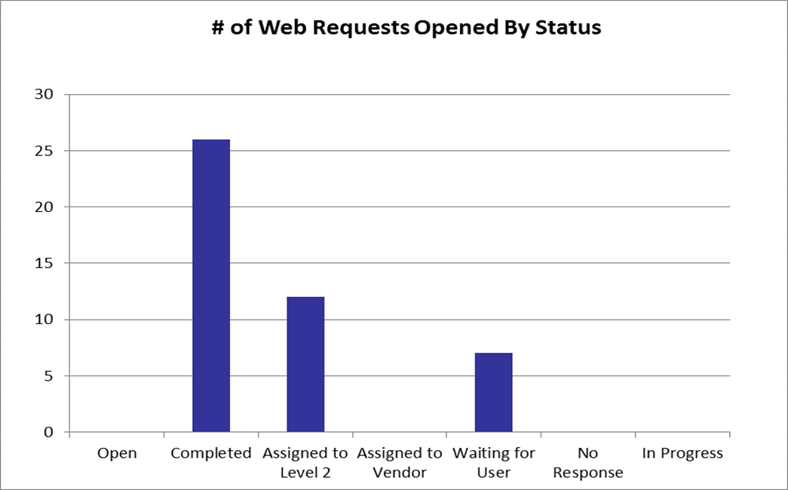
USCAUXILIARYSERVICESIT
Service Desk Reports
June 2017

Slide 8
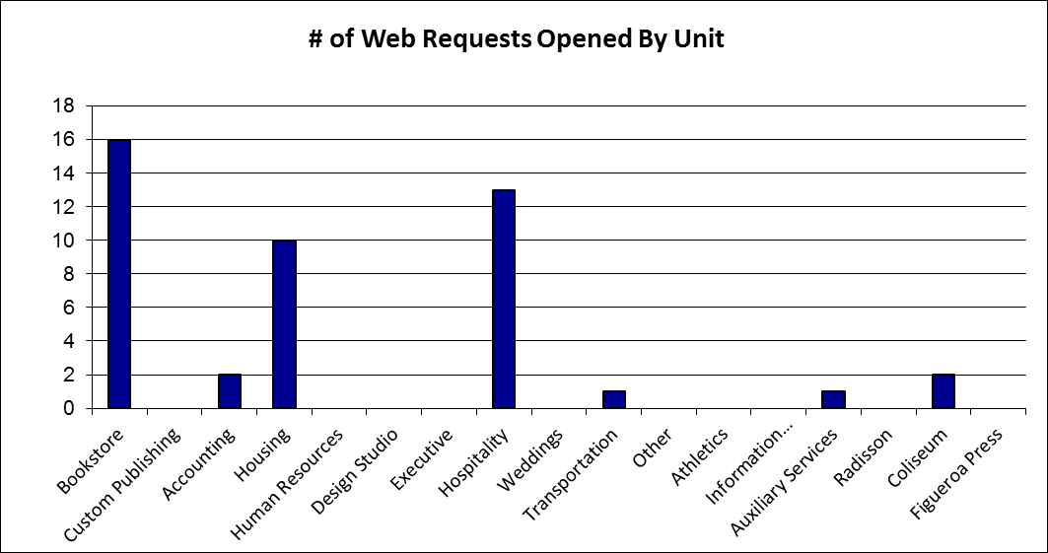
USCAUXILIARYSERVICESIT
Service Desk Reports
June 2017

Slide 9
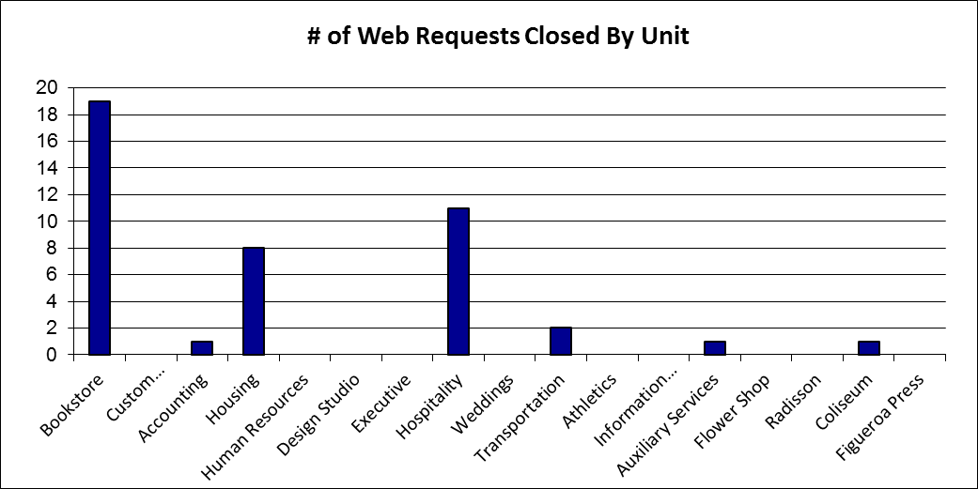
USCAUXILIARYSERVICESIT
Service Desk Reports
June 2017

Slide 10
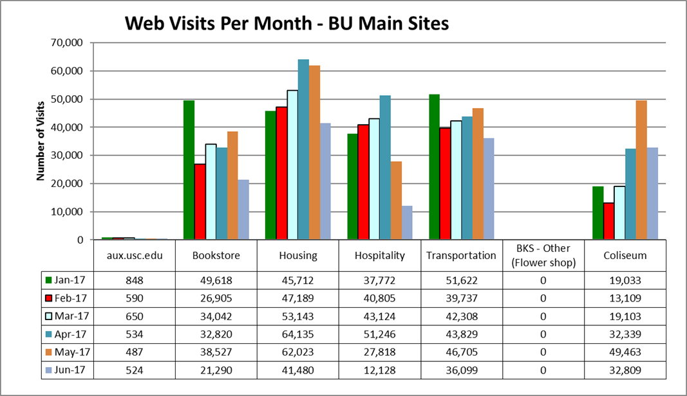
USCAUXILIARYSERVICESIT
Website Reports
June 2017

Slide 11
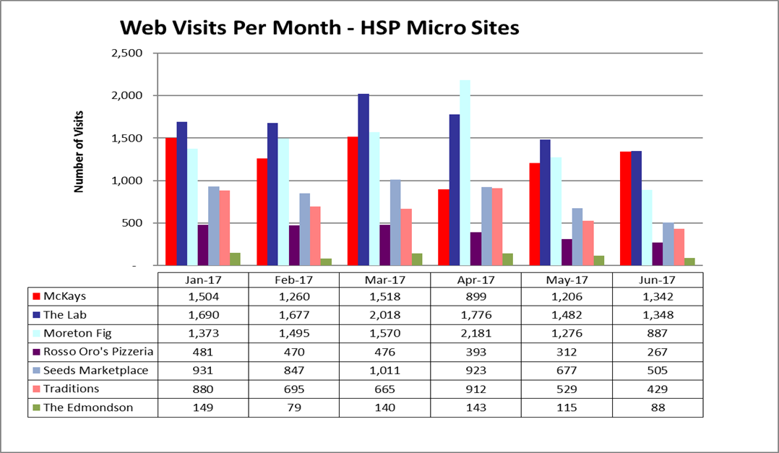
USCAUXILIARYSERVICESIT
Website Reports
June 2017

Slide 12
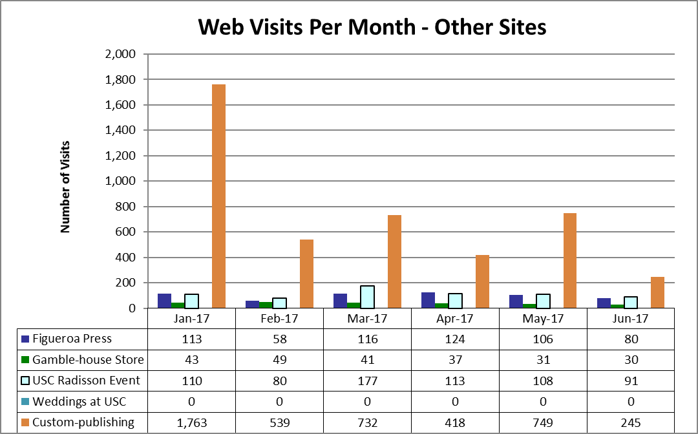
USCAUXILIARYSERVICESIT
Website Reports
June 2017
Notes:
USC Auxiliary Services Central IT - Individual Accomplishments
June 4, 2008
12

Slide 13
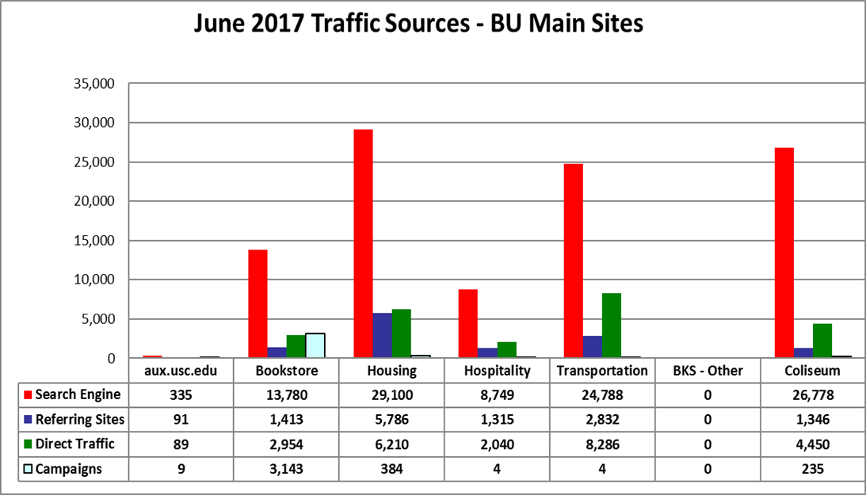
USCAUXILIARYSERVICESIT
Website Reports
June 2017

Slide 14
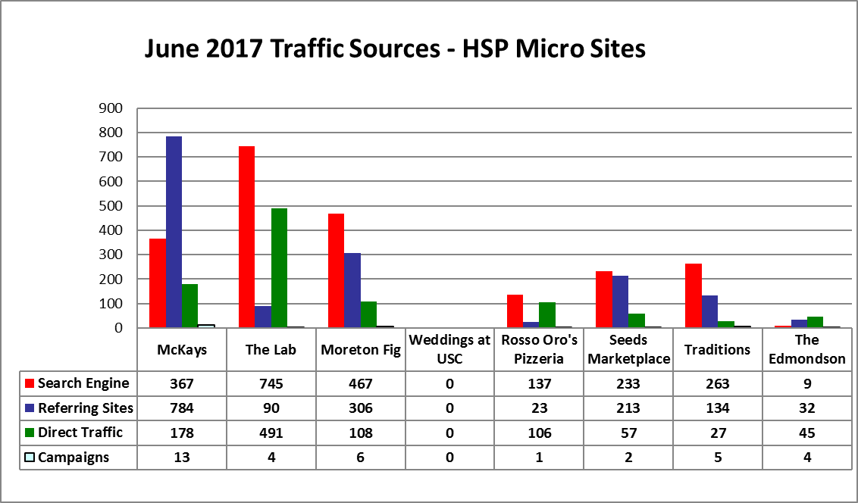
USCAUXILIARYSERVICESIT
Website Reports
June 2017

Slide 15
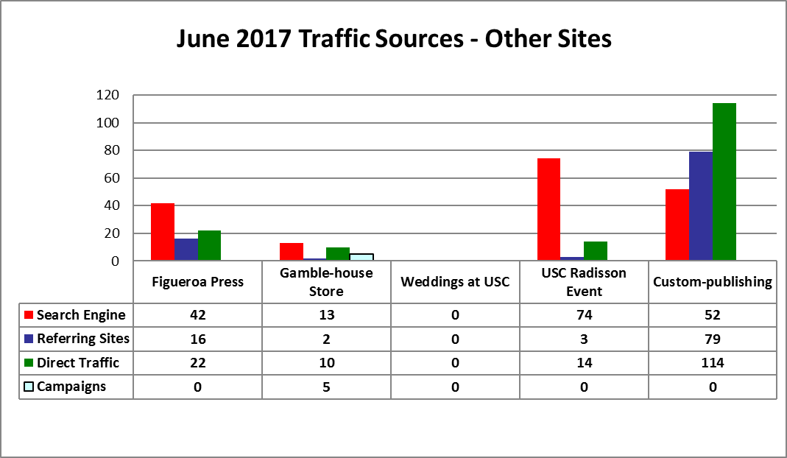
USCAUXILIARYSERVICESIT
Website Reports
June 2017

Slide 16
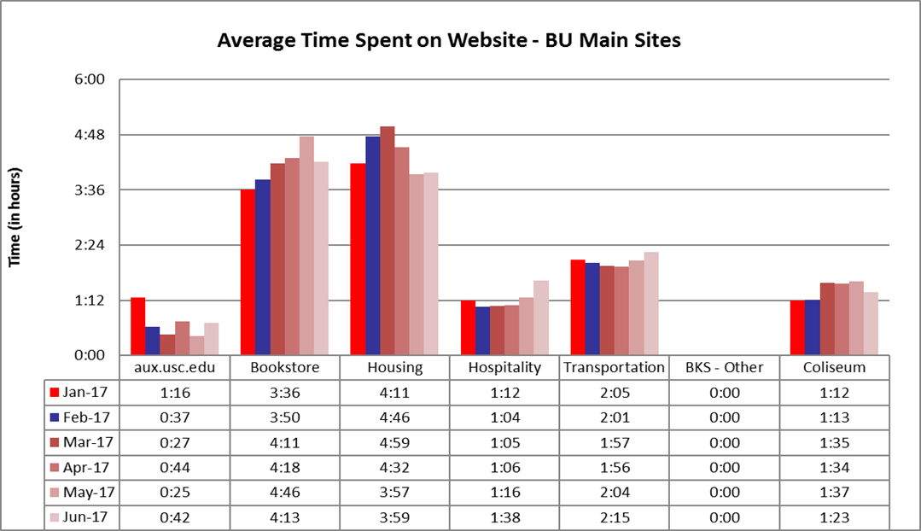
USCAUXILIARYSERVICESIT
Website Reports
June 2017

Slide 17
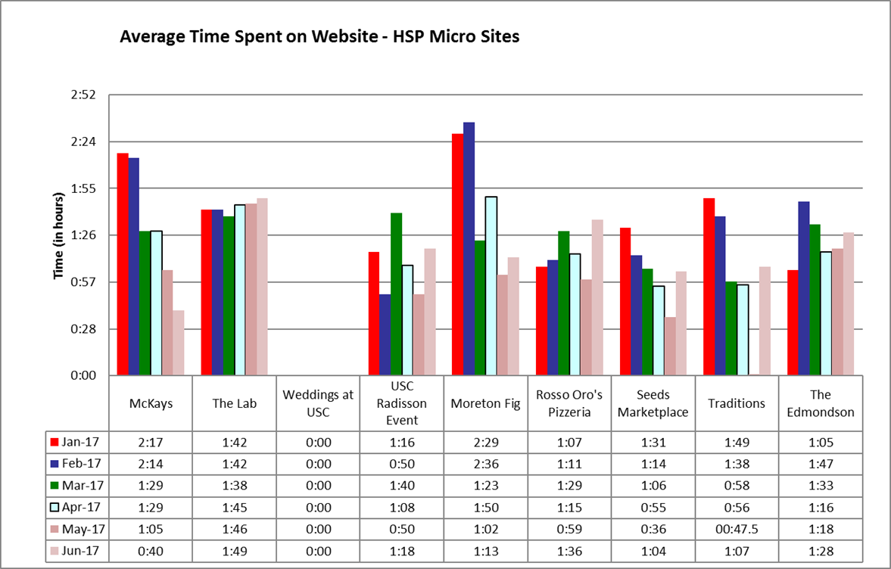
USCAUXILIARYSERVICESIT
Website Reports
June 2017

Slide 18
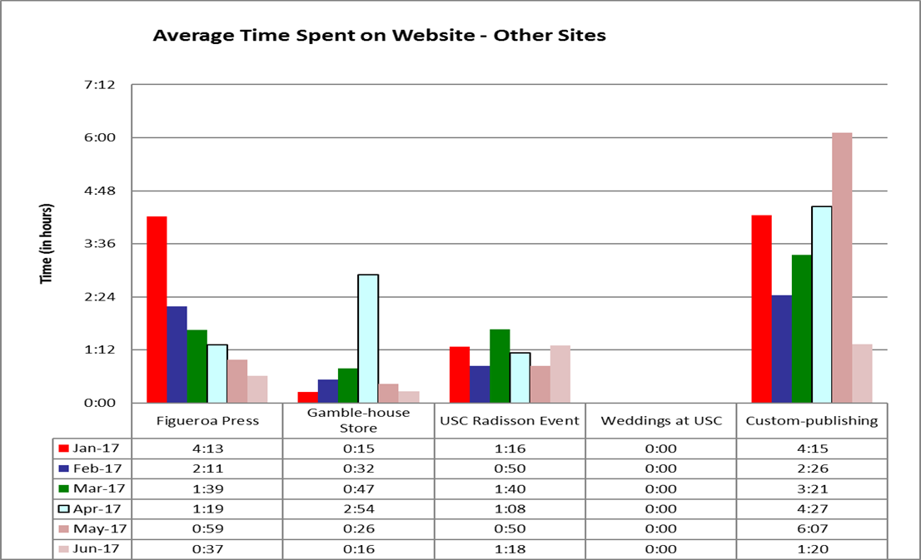
USCAUXILIARYSERVICESIT
Website Reports
June 2017

Slide 19
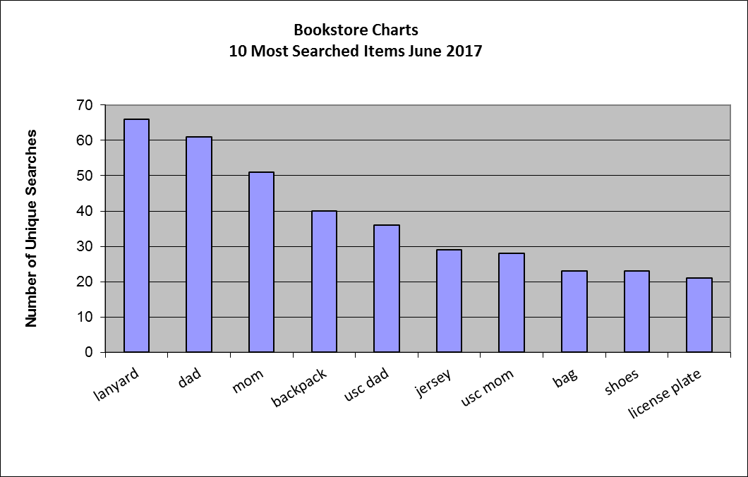
USCAUXILIARYSERVICESIT
Website Reports
June 2017

Slide 20
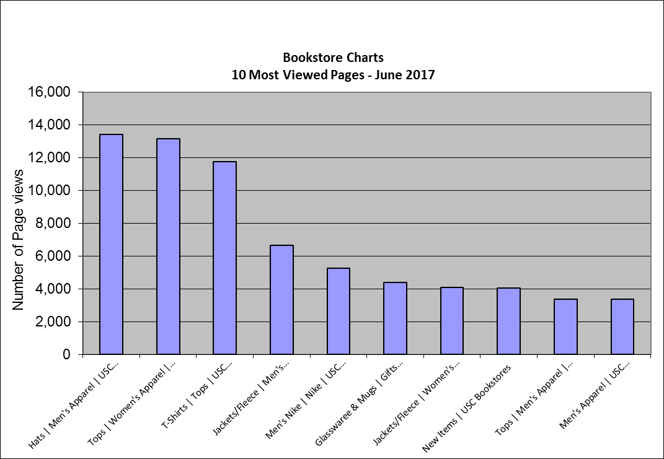
USCAUXILIARYSERVICESIT
Website Reports
June 2017

Slide 21
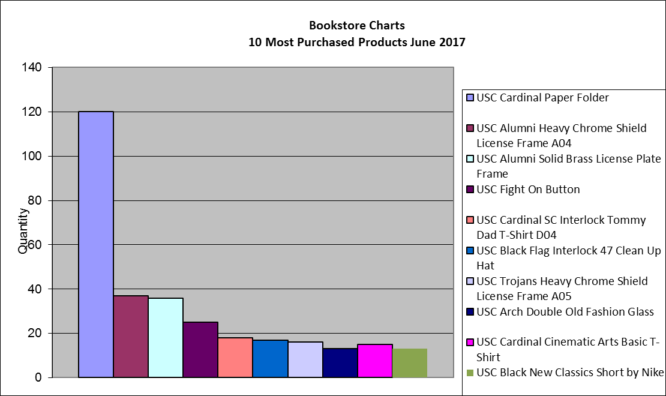
USCAUXILIARYSERVICESIT
Website Reports
June 2017

Slide 22
USCAUXILIARYSERVICESIT
Website Reports
June 2017

Slide 23
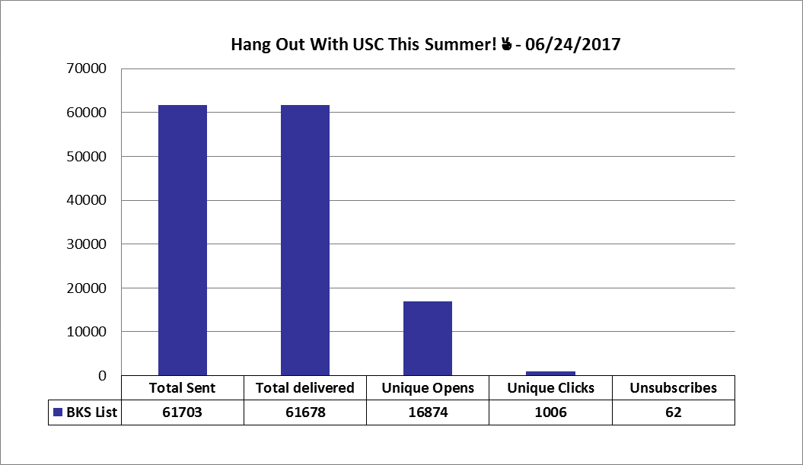
USCAUXILIARYSERVICESIT
Email Campaign Reports
June 2017

Slide 24
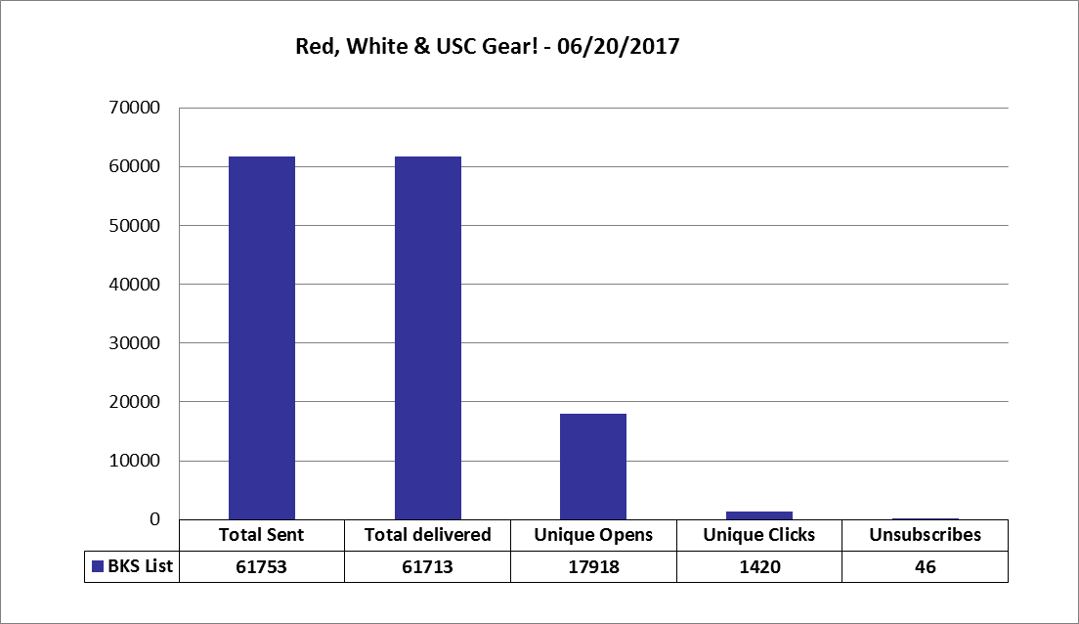
USCAUXILIARYSERVICESIT
Email Campaign Reports
June 2017

Slide 25
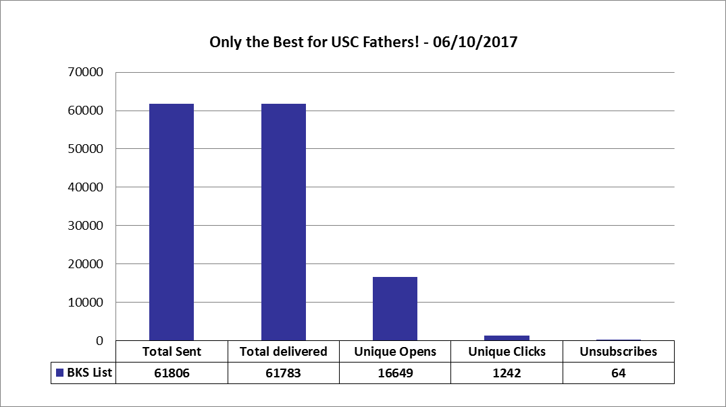
USCAUXILIARYSERVICESIT
Email Campaign Reports
June 2017

Slide 26
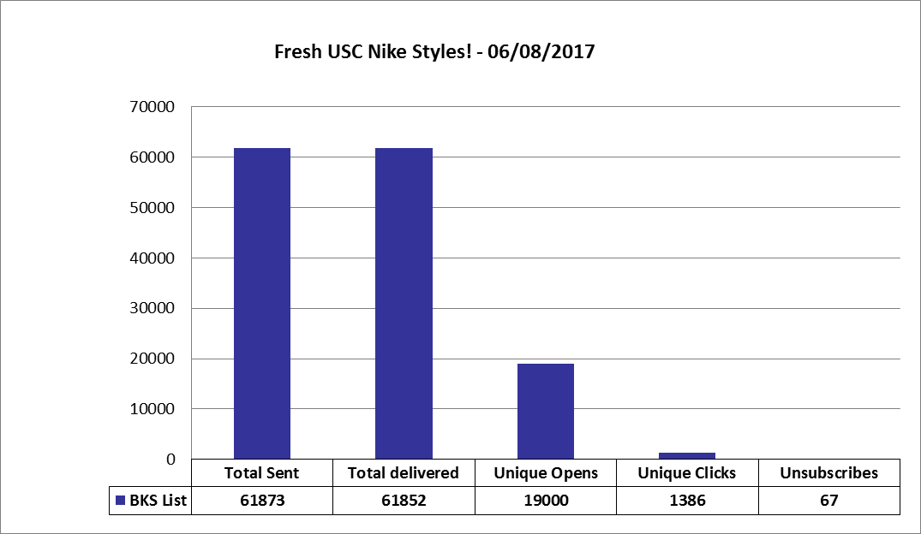
USCAUXILIARYSERVICESIT
Email Campaign Reports
June 2017

Slide 27
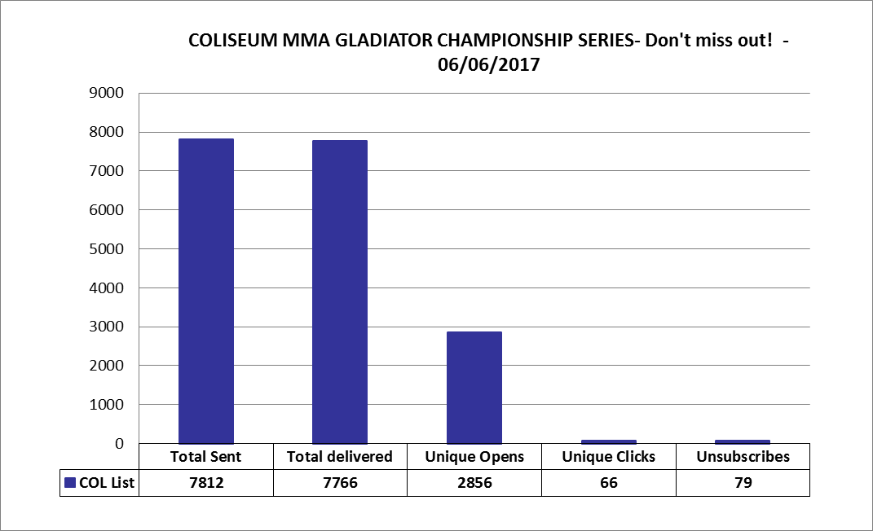
USCAUXILIARYSERVICESIT
Email Campaign Reports
June 2017

Slide 28
USCAUXILIARYSERVICESIT
Email Campaign Reports
June 2017

Slide 29
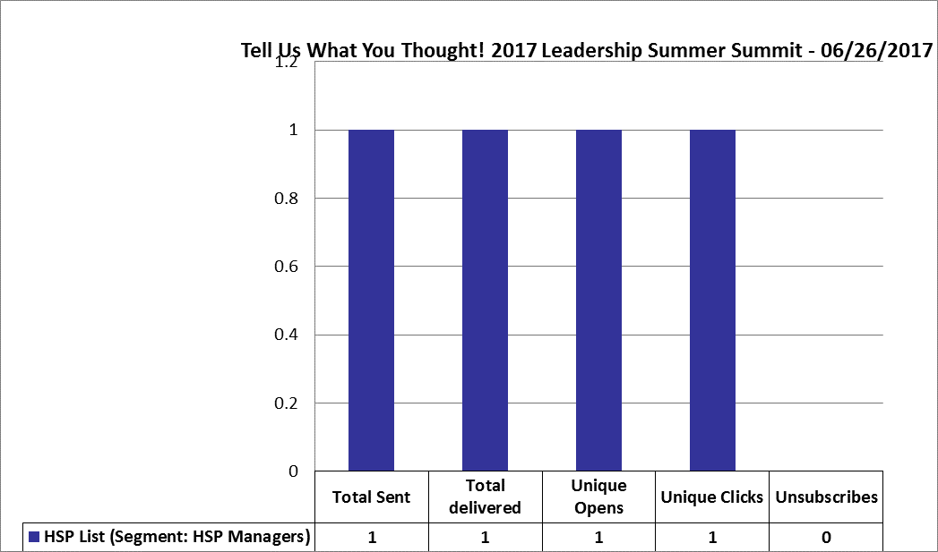
USCAUXILIARYSERVICESIT
Email Campaign Reports
June 2017

Slide 30
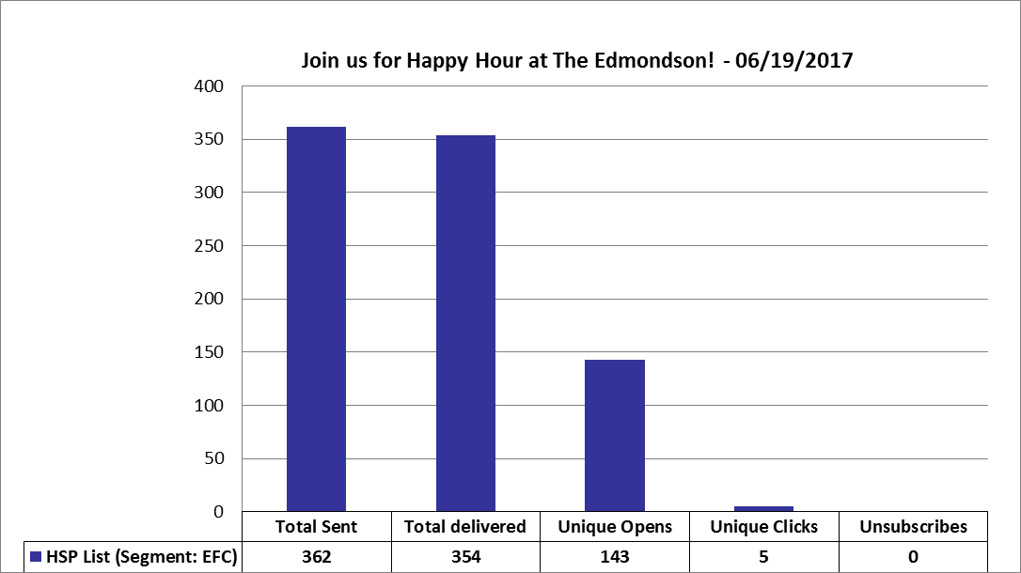
USCAUXILIARYSERVICESIT
Email Campaign Reports
June 2017

Slide 31
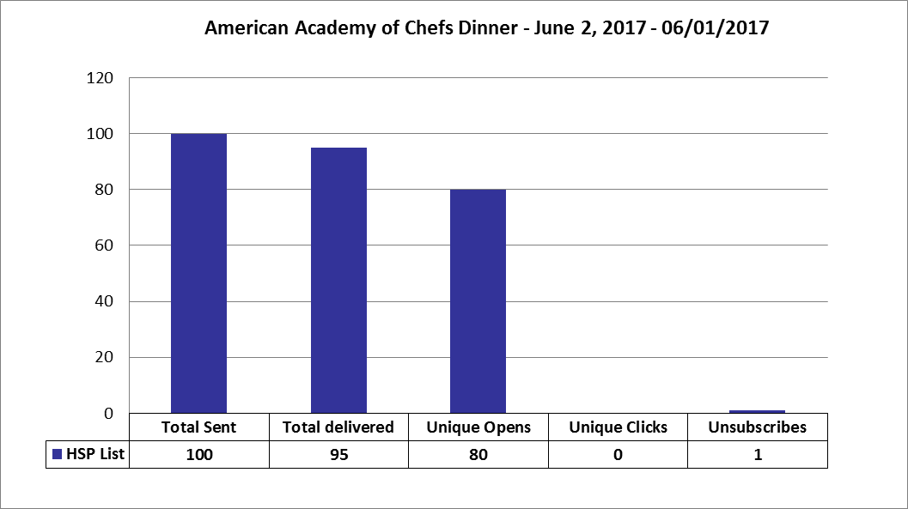
USCAUXILIARYSERVICESIT
Email Campaign Reports
June 2017

Slide 32
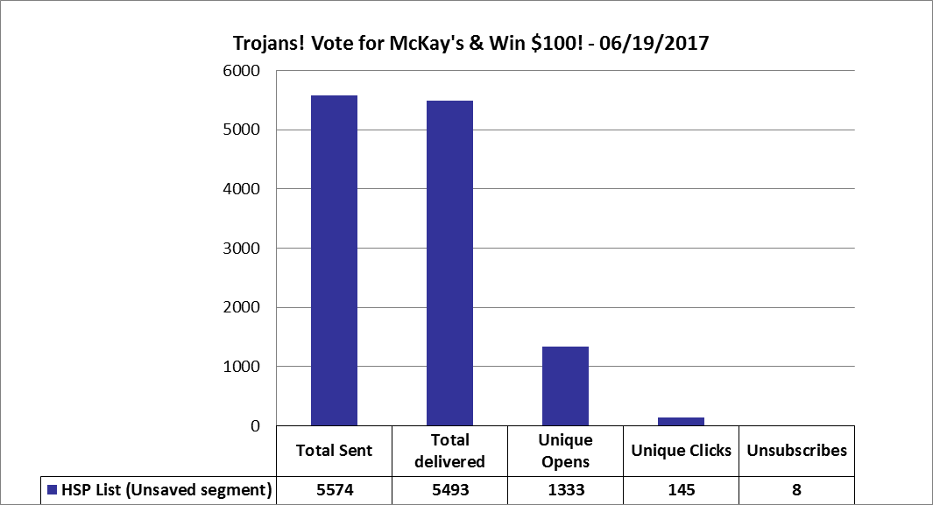
USCAUXILIARYSERVICESIT
Email Campaign Reports
June 2017

Slide 33
USCAUXILIARYSERVICESIT
Customer Satisfaction Report
June 2017

Slide 34
Thank You !!

