Slide 1
AUXILIARYSERVICES
I T
AS IT MONTHLY REPORTS
For March 2017
Notes:
1
Boo
May 4, 2008
USC Auxiliary Services Central IT - Individual Accomplishments

Slide 2
USCAUXILIARY SERVICESIT
AGENDA
Service Desk Reports
Aging Report
Website Reports
Email Campaign Reports
Customer Satisfaction Report

Slide 3
USCAUXILIARYSERVICESIT
Service Desk Reports
March 2017

Slide 4
USCAUXILIARYSERVICESIT
Service Desk Reports
March 2017

Slide 5
USCAUXILIARYSERVICESIT
Service Desk Reports
March 2017

Slide 6
USCAUXILIARYSERVICESIT
Service Desk Reports
March 2017

Slide 7
USCAUXILIARYSERVICESIT
Service Desk Reports
March 2017

Slide 8
USCAUXILIARYSERVICESIT
Service Desk Reports
March 2017

Slide 9
USCAUXILIARYSERVICESIT
Service Desk Reports
March 2017

Slide 10
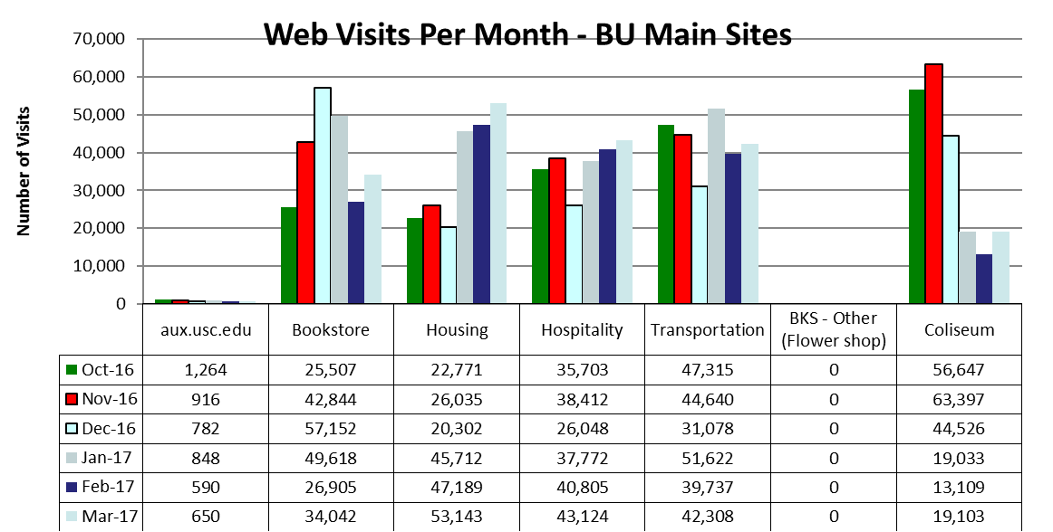
USCAUXILIARYSERVICESIT
Website Reports
March 2017

Slide 11
USCAUXILIARYSERVICESIT
Website Reports
March 2017

Slide 12
USCAUXILIARYSERVICESIT
Website Reports
March 2017
Notes:
USC Auxiliary Services Central IT - Individual Accomplishments
May 4, 2008
12

Slide 13
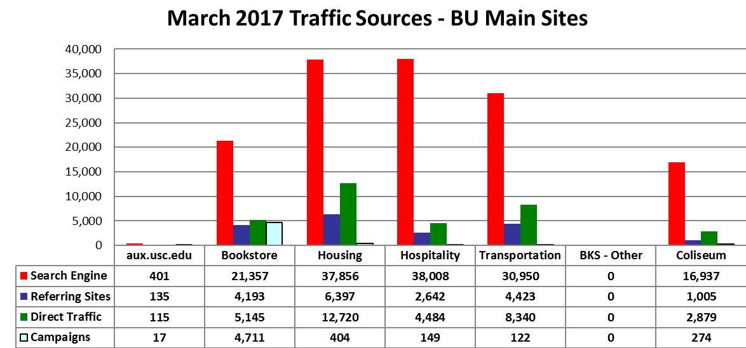
USCAUXILIARYSERVICESIT
Website Reports
March 2017

Slide 14
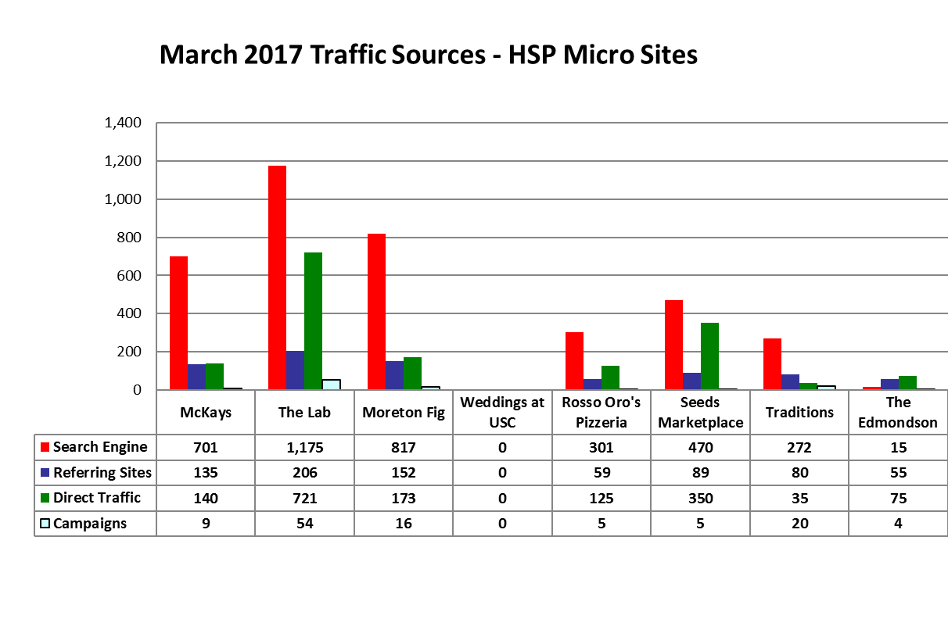
USCAUXILIARYSERVICESIT
Website Reports
March 2017

Slide 15
USCAUXILIARYSERVICESIT
Website Reports
March 2017

Slide 16
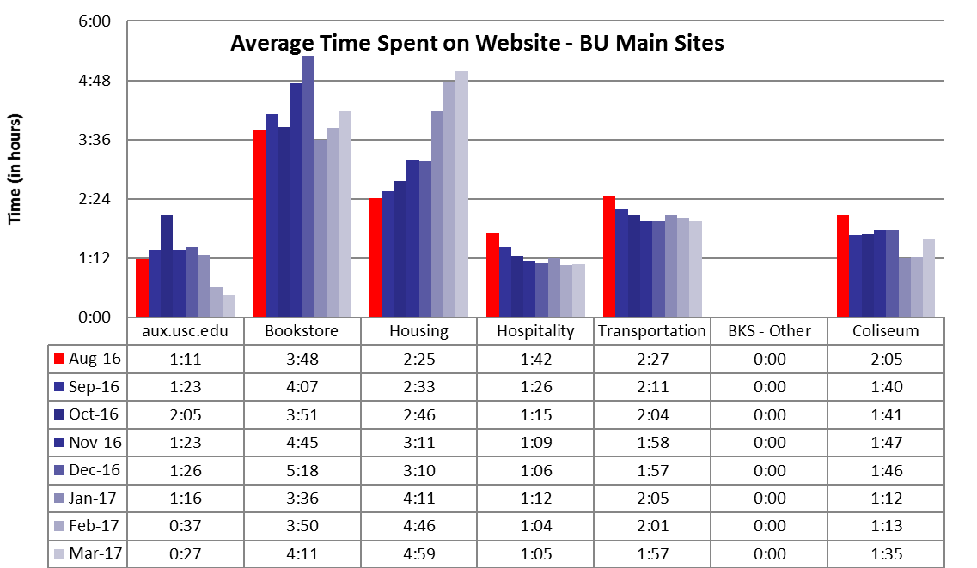
USCAUXILIARYSERVICESIT
Website Reports
March 2017

Slide 17
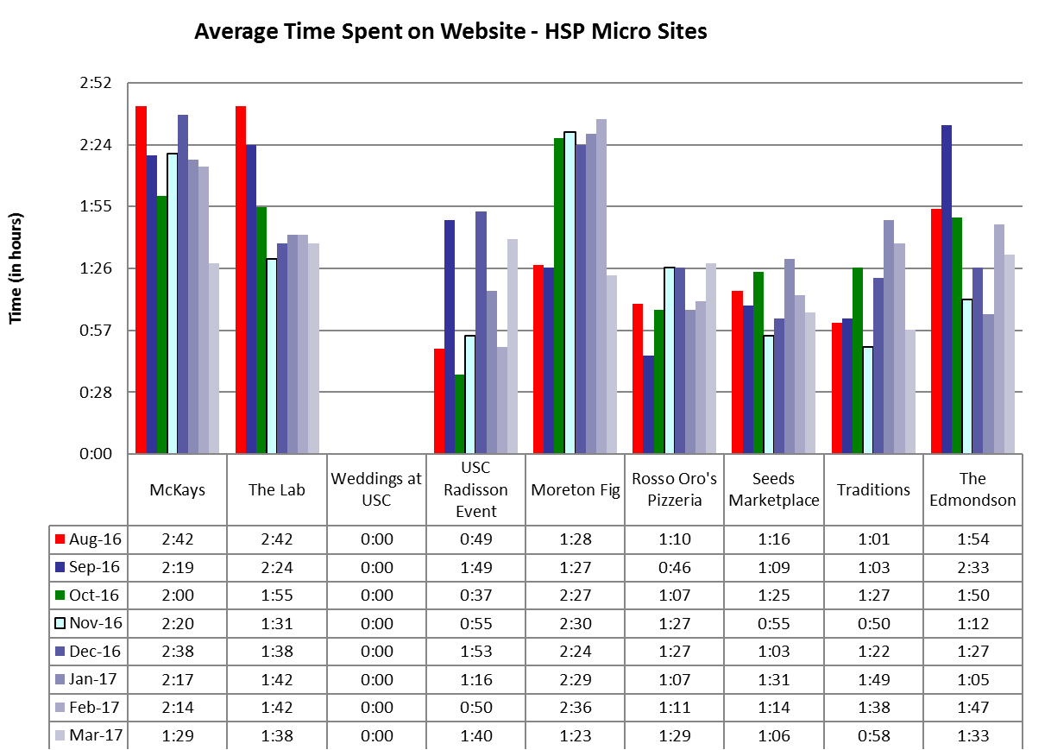
USCAUXILIARYSERVICESIT
Website Reports
March 2017

Slide 18
USCAUXILIARYSERVICESIT
Website Reports
March 2017

Slide 19
USCAUXILIARYSERVICESIT
Website Reports
March 2017

Slide 20
USCAUXILIARYSERVICESIT
Website Reports
March 2017

Slide 21
USCAUXILIARYSERVICESIT
Website Reports
March 2017

Slide 22
USCAUXILIARYSERVICESIT
Website Reports
March 2017

Slide 23
USCAUXILIARYSERVICESIT
Email Campaign Reports
March 2017

Slide 24
USCAUXILIARYSERVICESIT
Email Campaign Reports
March 2017

Slide 25
USCAUXILIARYSERVICESIT
Email Campaign Reports
March 2017

Slide 26
USCAUXILIARYSERVICESIT
Email Campaign Reports
March 2017

Slide 27
USCAUXILIARYSERVICESIT
Email Campaign Reports
March 2017

Slide 28
USCAUXILIARYSERVICESIT
Email Campaign Reports
March 2017

Slide 29
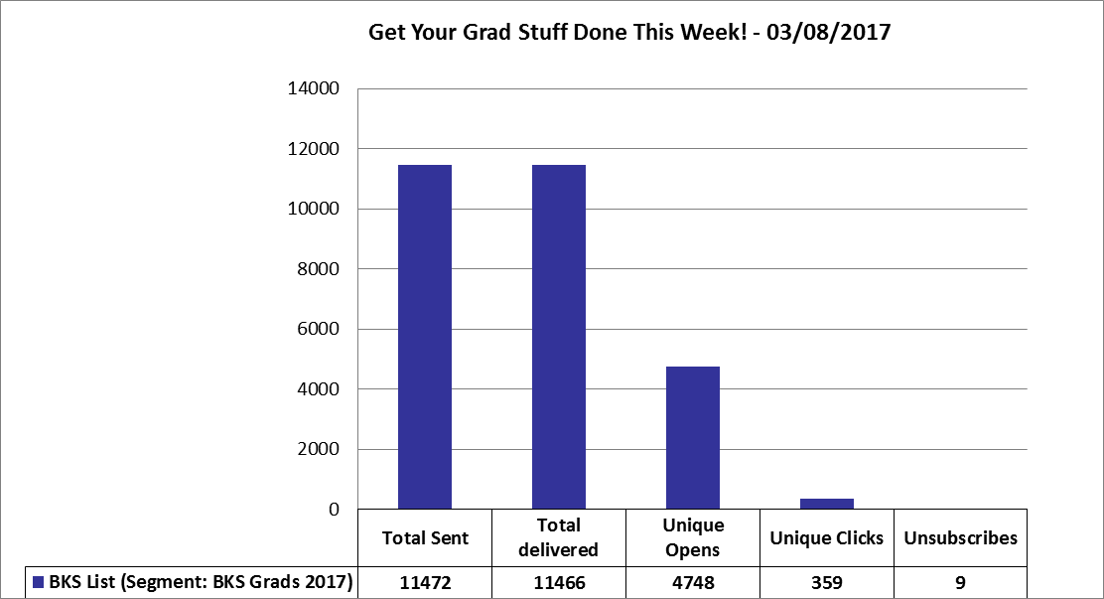
USCAUXILIARYSERVICESIT
Email Campaign Reports
March 2017

Slide 30
USCAUXILIARYSERVICESIT
Email Campaign Reports
March 2017

Slide 31
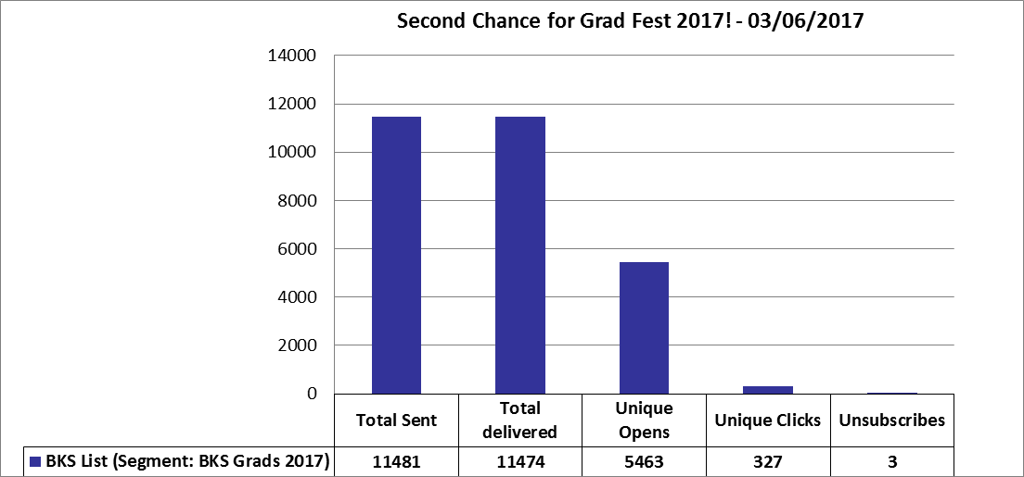
USCAUXILIARYSERVICESIT
Email Campaign Reports
March 2017

Slide 32
USCAUXILIARYSERVICESIT
Email Campaign Reports
March 2017

Slide 33
USCAUXILIARYSERVICESIT
Email Campaign Reports
March 2017

Slide 34
USCAUXILIARYSERVICESIT
Email Campaign Reports
March 2017

Slide 35
USCAUXILIARYSERVICESIT
Email Campaign Reports
March 2017

Slide 36
USCAUXILIARYSERVICESIT
Email Campaign Reports
March 2017

Slide 37
USCAUXILIARYSERVICESIT
Email Campaign Reports
March 2017

Slide 38
USCAUXILIARYSERVICESIT
Email Campaign Reports
March 2017

Slide 39
USCAUXILIARYSERVICESIT
Email Campaign Reports
March 2017

Slide 40
USCAUXILIARYSERVICESIT
Email Campaign Reports
March 2017

Slide 41
USCAUXILIARYSERVICESIT
Email Campaign Reports
March 2017

Slide 42
USCAUXILIARYSERVICESIT
Email Campaign Reports
March 2017

Slide 43
USCAUXILIARYSERVICESIT
Email Campaign Reports
March 2017

Slide 44
USCAUXILIARYSERVICESIT
Email Campaign Reports
March 2017

Slide 45
USCAUXILIARYSERVICESIT
Email Campaign Reports
March 2017

Slide 46
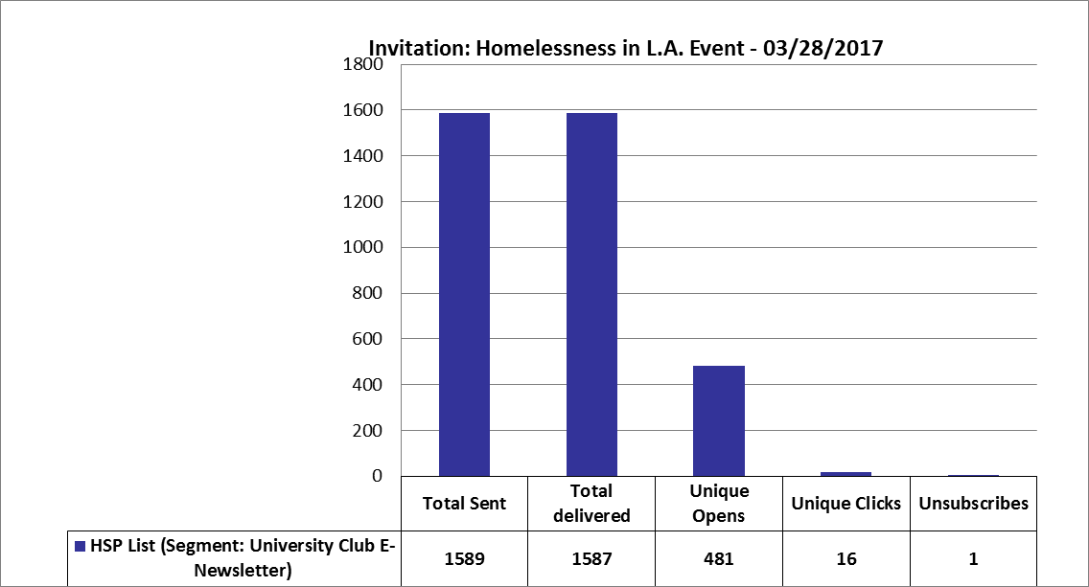
USCAUXILIARYSERVICESIT
Email Campaign Reports
March 2017

Slide 47
USCAUXILIARYSERVICESIT
Email Campaign Reports
March 2017

Slide 48
USCAUXILIARYSERVICESIT
Email Campaign Reports
March 2017

Slide 49
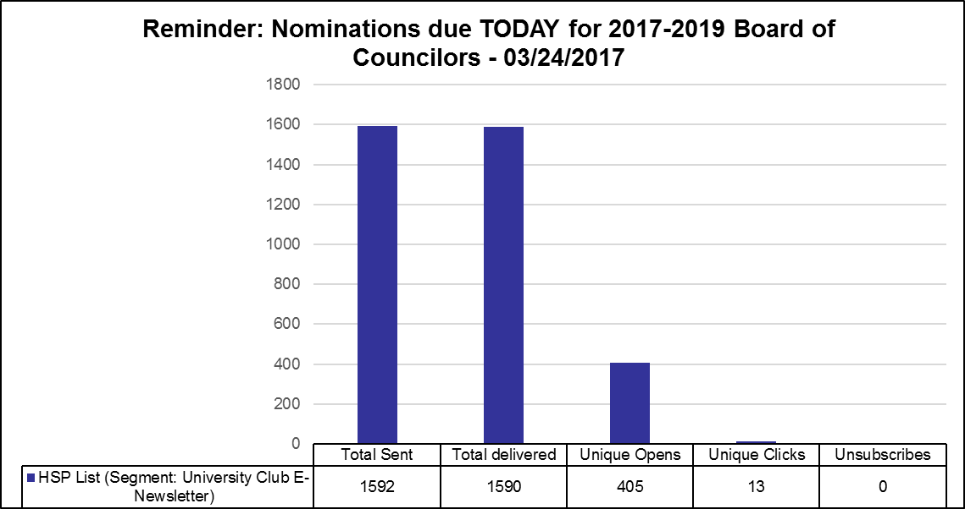
USCAUXILIARYSERVICESIT
Email Campaign Reports
March 2017

Slide 50
USCAUXILIARYSERVICESIT
Email Campaign Reports
March 2017

Slide 51
USCAUXILIARYSERVICESIT
Email Campaign Reports
March 2017

Slide 52
USCAUXILIARYSERVICESIT
Email Campaign Reports
March 2017

Slide 53
USCAUXILIARYSERVICESIT
Email Campaign Reports
March 2017

Slide 54
USCAUXILIARYSERVICESIT
Email Campaign Reports
March 2017

Slide 55
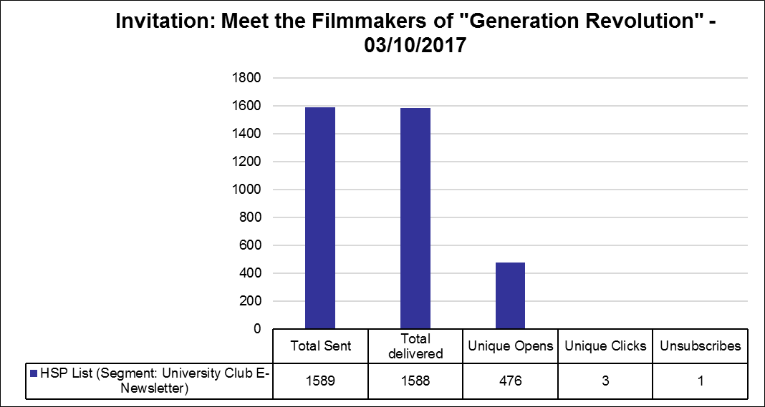
USCAUXILIARYSERVICESIT
Email Campaign Reports
March 2017

Slide 56
USCAUXILIARYSERVICESIT
Email Campaign Reports
March 2017

Slide 57
USCAUXILIARYSERVICESIT
Email Campaign Reports
March 2017

Slide 58
USCAUXILIARYSERVICESIT
Email Campaign Reports
March 2017

Slide 59
USCAUXILIARYSERVICESIT
Customer Satisfaction Report
March 2017

Slide 60
Thank You !!

