Slide 1
AUXILIARYSERVICES
I T
AS IT MONTHLY REPORTS
For January 2017
Notes:
1
Boo
May 4, 2008
USC Auxiliary Services Central IT - Individual Accomplishments

Slide 2
USCAUXILIARY SERVICESIT
AGENDA
Service Desk Reports
Aging Report
Website Reports
Email Campaign Reports
Customer Satisfaction Report

Slide 3
USCAUXILIARYSERVICESIT
Service Desk Reports
January 2017

Slide 4
USCAUXILIARYSERVICESIT
Service Desk Reports
January 2017

Slide 5
USCAUXILIARYSERVICESIT
Service Desk Reports
January 2017

Slide 6
USCAUXILIARYSERVICESIT
Service Desk Reports
January 2017

Slide 7
USCAUXILIARYSERVICESIT
Service Desk Reports
January 2017

Slide 8
USCAUXILIARYSERVICESIT
Service Desk Reports
January 2017

Slide 9
USCAUXILIARYSERVICESIT
Service Desk Reports
January 2017

Slide 10
USCAUXILIARYSERVICESIT
Website Reports
January 2017

Slide 11
USCAUXILIARYSERVICESIT
Website Reports
January 2017

Slide 12
USCAUXILIARYSERVICESIT
Website Reports
January 2017
Notes:
USC Auxiliary Services Central IT - Individual Accomplishments
May 4, 2008
12

Slide 13
USCAUXILIARYSERVICESIT
Website Reports
January 2017

Slide 14
USCAUXILIARYSERVICESIT
Website Reports
January 2017

Slide 15
USCAUXILIARYSERVICESIT
Website Reports
January 2017

Slide 16
USCAUXILIARYSERVICESIT
Website Reports
January 2017

Slide 17
USCAUXILIARYSERVICESIT
Website Reports
January 2017

Slide 18
USCAUXILIARYSERVICESIT
Website Reports
January 2017

Slide 19
USCAUXILIARYSERVICESIT
Website Reports
January 2017

Slide 20
USCAUXILIARYSERVICESIT
Website Reports
January 2017

Slide 21
USCAUXILIARYSERVICESIT
Website Reports
January 2017

Slide 22
USCAUXILIARYSERVICESIT
Website Reports
January 2017

Slide 23
USCAUXILIARYSERVICESIT
Email Campaign Reports
January 2017

Slide 24
USCAUXILIARYSERVICESIT
Email Campaign Reports
January 2017

Slide 25
USCAUXILIARYSERVICESIT
Email Campaign Reports
January 2017

Slide 26
USCAUXILIARYSERVICESIT
Email Campaign Reports
January 2017

Slide 27
USCAUXILIARYSERVICESIT
Email Campaign Reports
January 2017

Slide 28
USCAUXILIARYSERVICESIT
Email Campaign Reports
January 2017

Slide 29
USCAUXILIARYSERVICESIT
Email Campaign Reports
January 2017

Slide 30
USCAUXILIARYSERVICESIT
Email Campaign Reports
January 2017

Slide 31
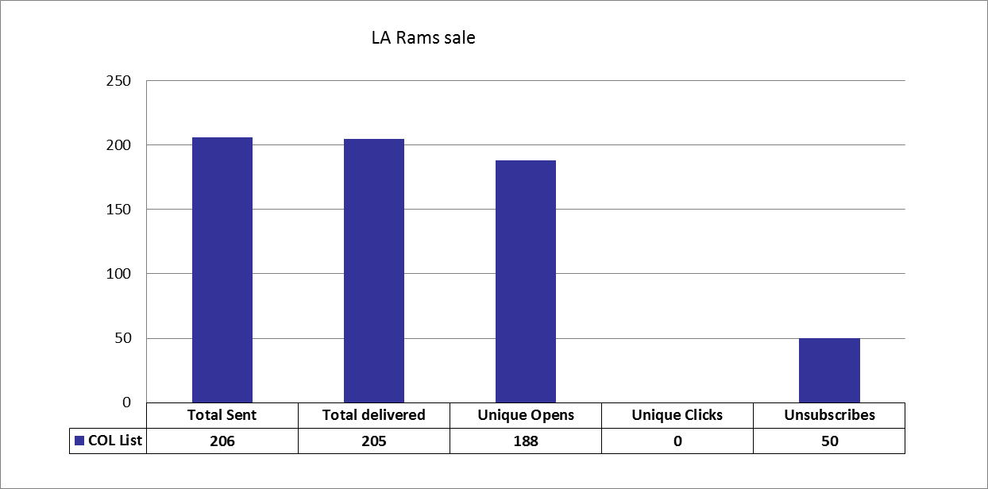
USCAUXILIARYSERVICESIT
Email Campaign Reports
January 2017

Slide 32
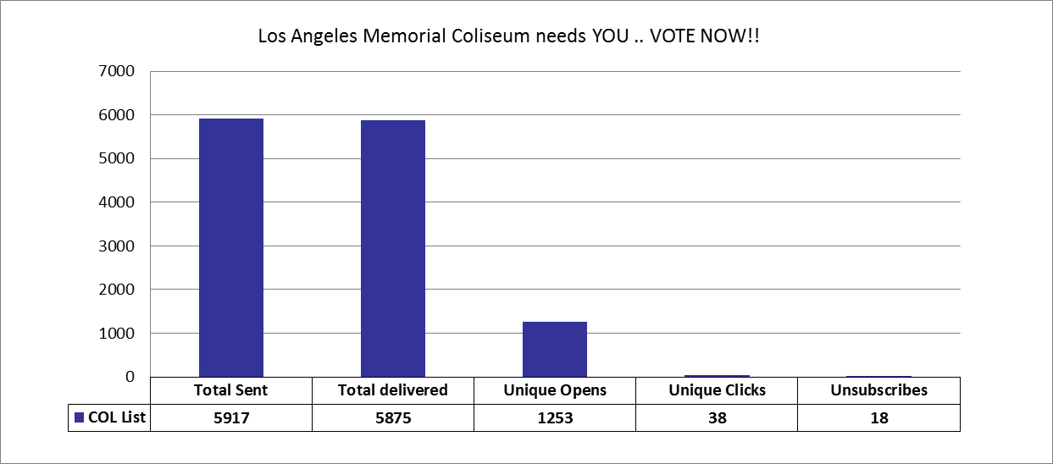
USCAUXILIARYSERVICESIT
Email Campaign Reports
January 2017

Slide 33
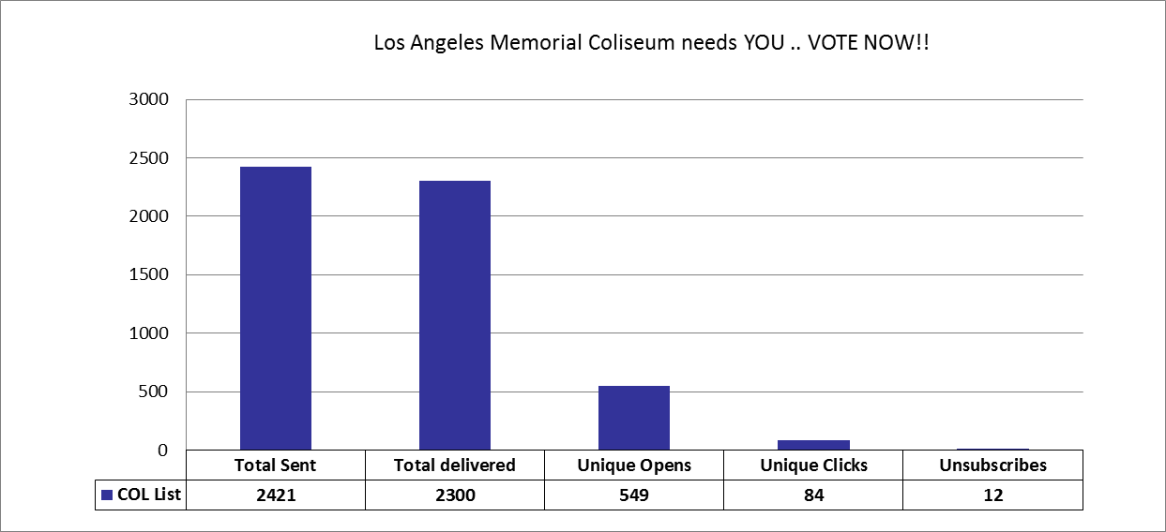
USCAUXILIARYSERVICESIT
Email Campaign Reports
January 2017

Slide 34
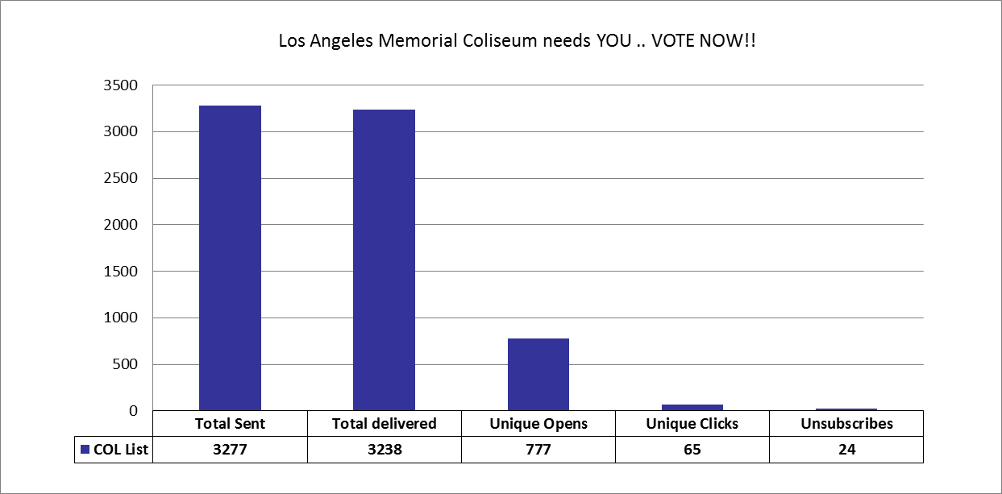
USCAUXILIARYSERVICESIT
Email Campaign Reports
January 2017

Slide 35
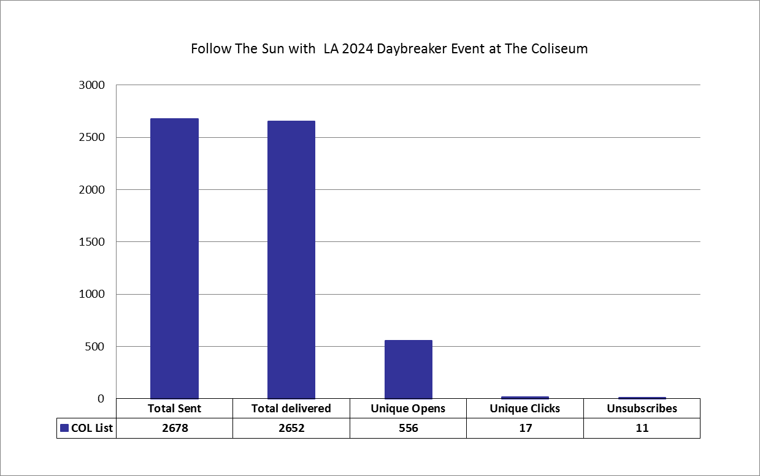
USCAUXILIARYSERVICESIT
Email Campaign Reports
January 2017

Slide 36
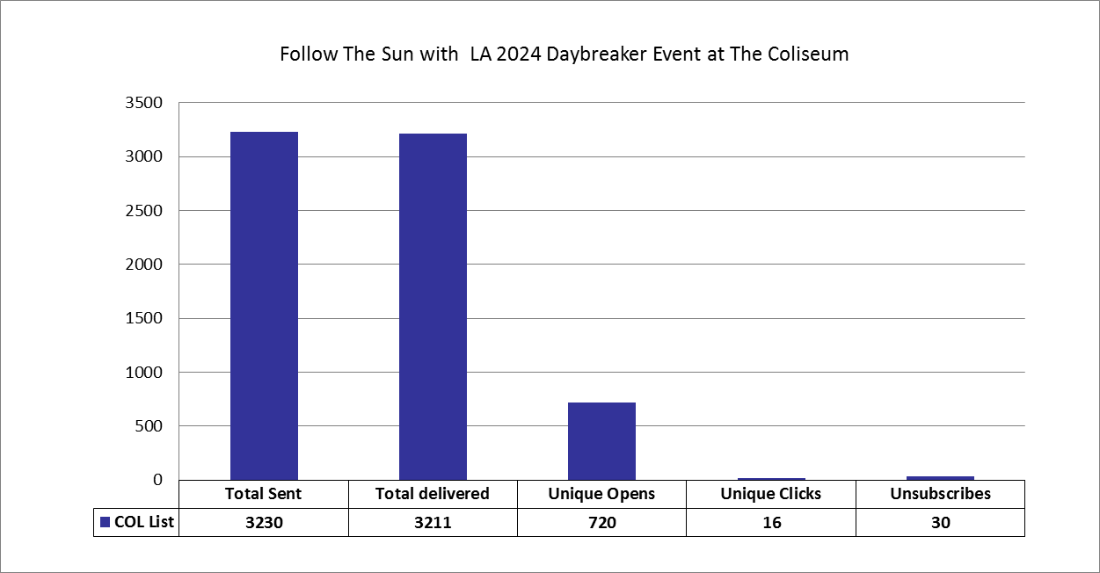
USCAUXILIARYSERVICESIT
Email Campaign Reports
January 2017

Slide 37
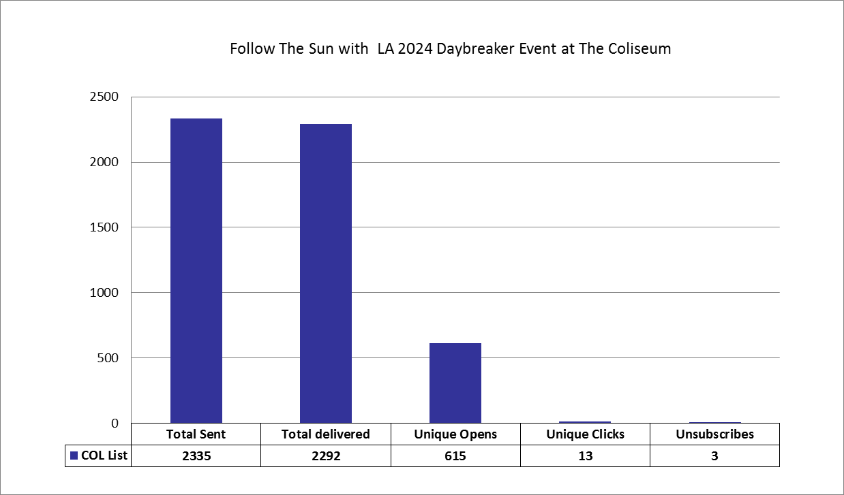
USCAUXILIARYSERVICESIT
Email Campaign Reports
January 2017

Slide 38
USCAUXILIARYSERVICESIT
Email Campaign Reports
January 2017

Slide 39
USCAUXILIARYSERVICESIT
Email Campaign Reports
January 2017

Slide 40
USCAUXILIARYSERVICESIT
Email Campaign Reports
January 2017

Slide 41
USCAUXILIARYSERVICESIT
Email Campaign Reports
January 2017

Slide 42
USCAUXILIARYSERVICESIT
Email Campaign Reports
January 2017

Slide 43
USCAUXILIARYSERVICESIT
Email Campaign Reports
January 2017

Slide 44
USCAUXILIARYSERVICESIT
Email Campaign Reports
January 2017

Slide 45
USCAUXILIARYSERVICESIT
Email Campaign Reports
January 2017

Slide 46
USCAUXILIARYSERVICESIT
Email Campaign Reports
January 2017

Slide 47
USCAUXILIARYSERVICESIT
Email Campaign Reports
January 2017

Slide 48
USCAUXILIARYSERVICESIT
Email Campaign Reports
January 2017

Slide 49
USCAUXILIARYSERVICESIT
Email Campaign Reports
January 2017

Slide 50
USCAUXILIARYSERVICESIT
Email Campaign Reports
January 2017

Slide 51
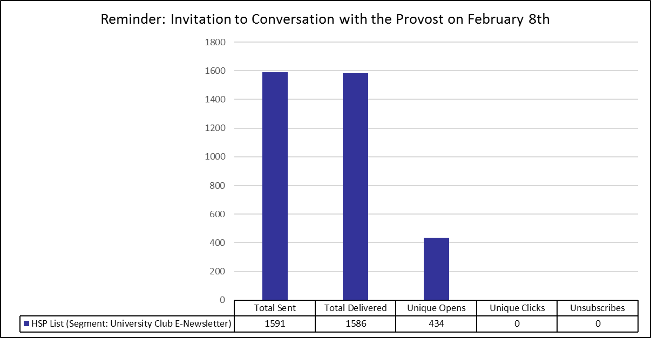
USCAUXILIARYSERVICESIT
Email Campaign Reports
January 2017

Slide 52
USCAUXILIARYSERVICESIT
Customer Satisfaction Report
January 2017

Slide 53
Thank You !!

